Slide 2
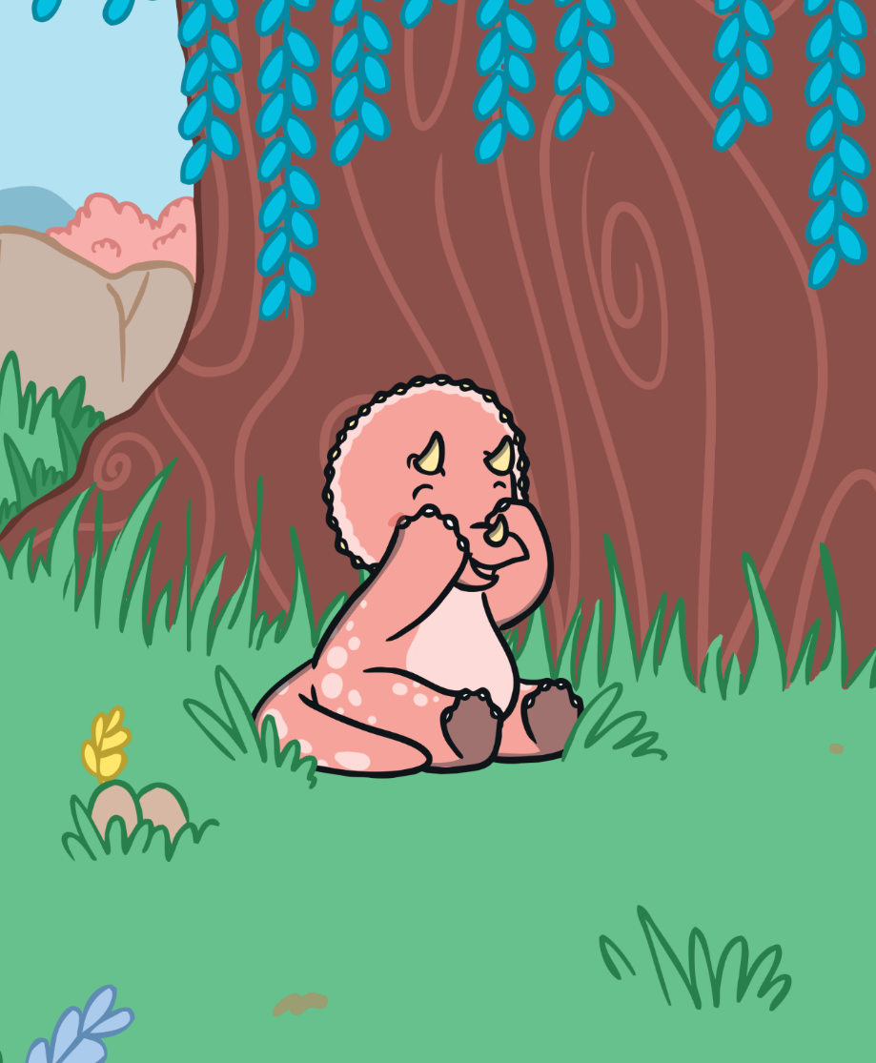
Hide-and-Seek!
Triceratops is trying to count all of the dinosaurs she finds in each game of hide-and-seek. But every time she thinks she’s found them all, she finds
one more!
Can you help Triceratops to work out how many dinosaurs she finds?

Slide 3
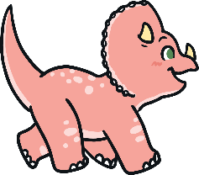



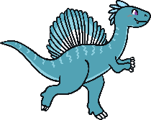
How Many Dinosaurs?
Triceratops finds 5 dinosaurs playing hide-and-seek.
Then she finds 1 more.
What is 1 more than 5?
Reveal Answer
0
1
2
3
4
5
6
7
8
9
10
One more than 5 is 6.

Slide 4


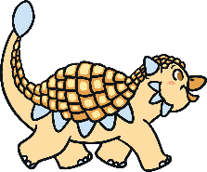
How Many Dinosaurs?
Triceratops finds 3 dinosaurs playing hide-and-seek.
Then she finds 1 more.
What is 1 more than 3?
Reveal Answer
0
1
2
3
4
5
6
7
8
9
10
One more than 3 is 4.

Slide 5



How Many Dinosaurs?
Triceratops finds 7 dinosaurs playing hide-and-seek.
Then she finds 1 more.
What is 1 more than 7?
Reveal Answer
0
1
2
3
4
5
6
7
8
9
10
One more than 7 is 8.

Slide 6
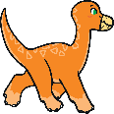

How Many Dinosaurs?
Triceratops finds 6 dinosaurs playing hide-and-seek.
Then she finds 1 more.
What is 1 more than 6?
Reveal Answer
0
1
2
3
4
5
6
7
8
9
10
One more than 6 is 7.

Slide 7

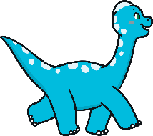

How Many Dinosaurs?
Triceratops finds 4 dinosaurs playing hide-and-seek.
Then she finds 1 more.
What is 1 more than 4?
Reveal Answer
0
1
2
3
4
5
6
7
8
9
10
One more than 4 is 5.

Slide 8


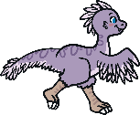
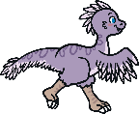
How Many Dinosaurs?
Triceratops finds 9 dinosaurs playing hide-and-seek.
Then she finds 1 more.
What is 1 more than 9?
Reveal Answer
0
1
2
3
4
5
6
7
8
9
10
One more than 9 is 10.

Slide 9
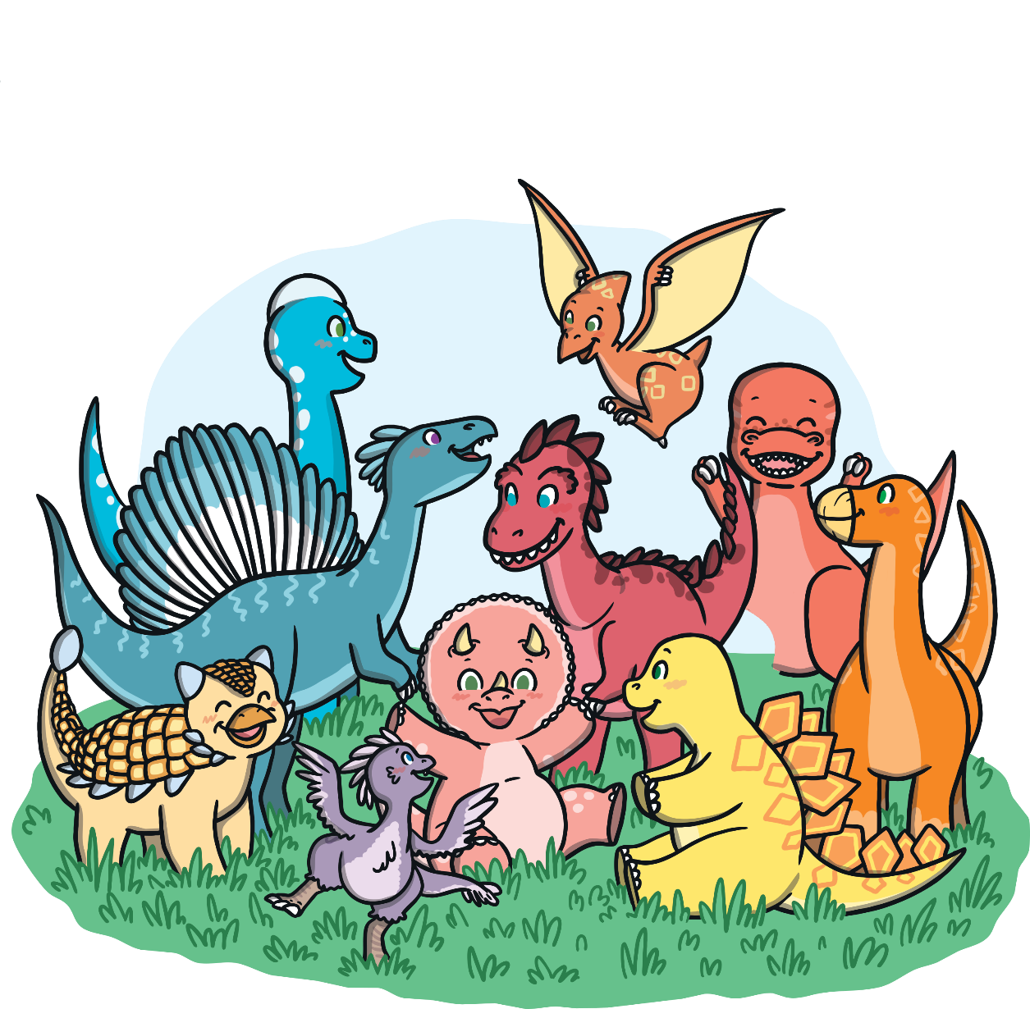
Triceratops has found all of her dinosaur friends!

