Slide 1
Introducing
Mrs Hodge

Slide 2
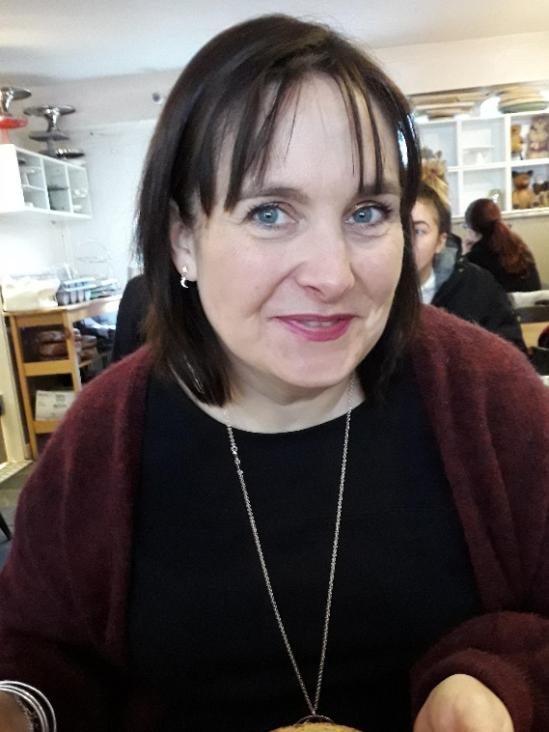
Hello.
I will be your new teacher in September, when you join Reception
We have only met briefly but I thought you might like to know a little bit more about me.

Slide 3
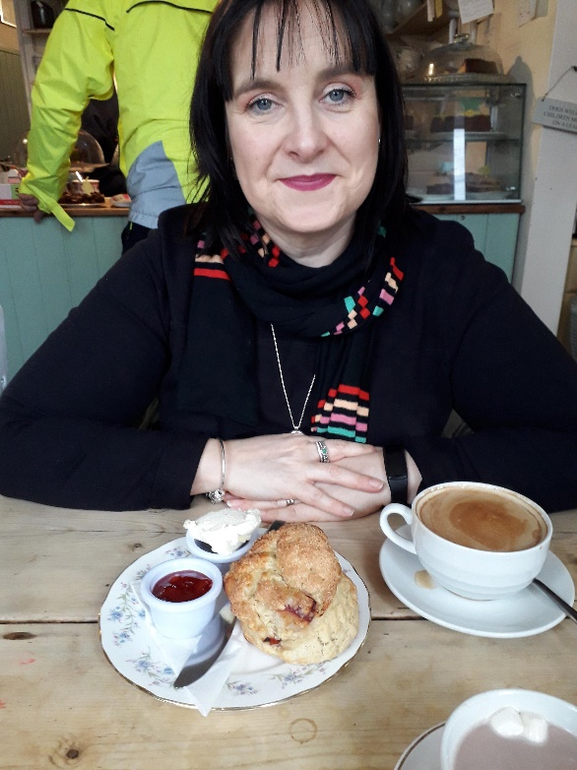
My name is Mrs Hodge
I love a Sunday morning treat of a coffee and a scone.
I have worked at St. Peter’s for 14 years, and I love it!
My favourite colour is red.

Slide 4
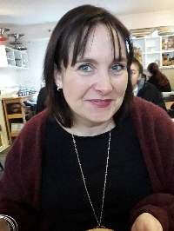
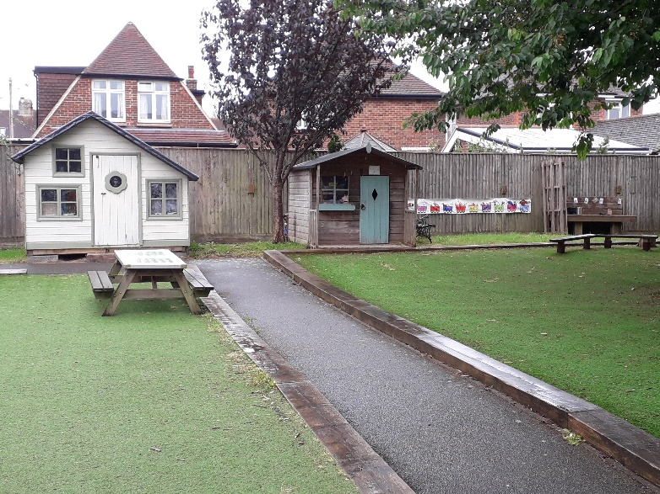
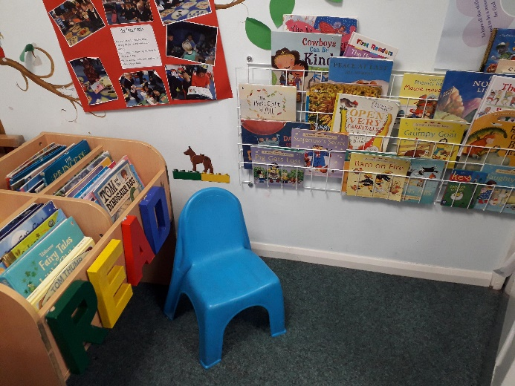
What is your favourite activity?
In the Reception environment I love the garden, the making area and the book corner…

Slide 5













Can you guess which of these I like and don’t like?

Slide 6
How many did you get right?
I like… I don’t like…

Slide 7
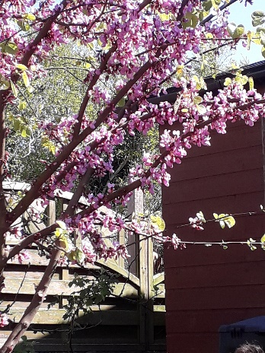
I live with Mr Hodge and my 2 children , Poppy who is 19 and Stanley is 16- they used to go to St Peter’s when they were little.
We love to sit in our garden under our blossom tree.

Slide 8
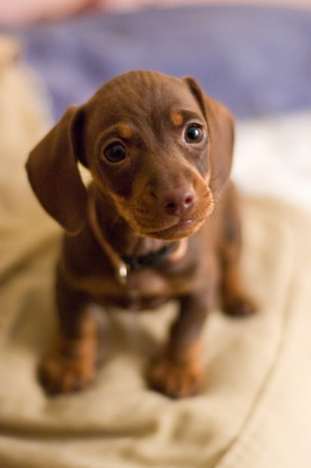
I don’t have any pets – if I did I would like one of these.

Slide 9
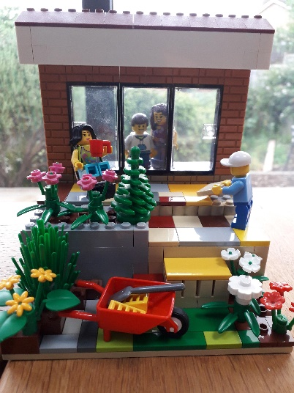
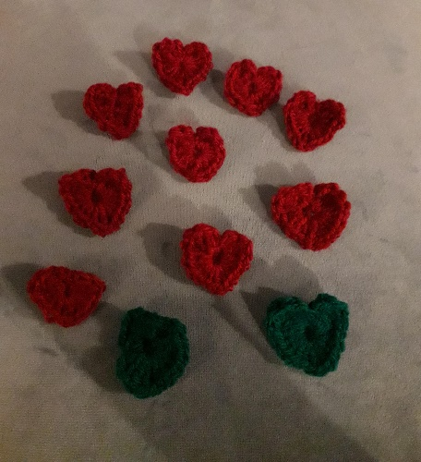
We like all different types of crafts in my family. I taught myself to knit and crochet. I sew, and I like using my sketch book.
We all love Lego.

Slide 10

I wonder what you are looking forward to?
I am really looking forward to meeting you properly soon.
I will putting things on our new class page to help you with your transition to school.

