Slide 1
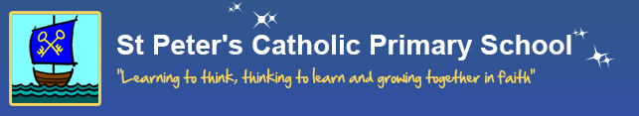
Reading In Year One
How do we teach reading at St. Peter’s?
17.10.22

Slide 2
Meeting focus:
When does reading take place?
Teaching reading through phonics (Read Write Inc.)
What is phonics?
Supporting phonics
Reading books that come home
Phonics screener
Animal words
Questions ☺

Slide 3
WHAT READING DO WE DO IN YEAR 1?
Read Write Inc. Sessions – groups
1:1 Reading
Regular Story Time

Slide 4
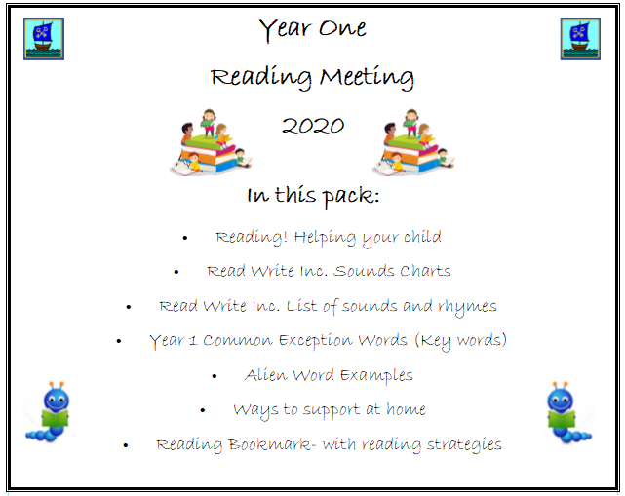
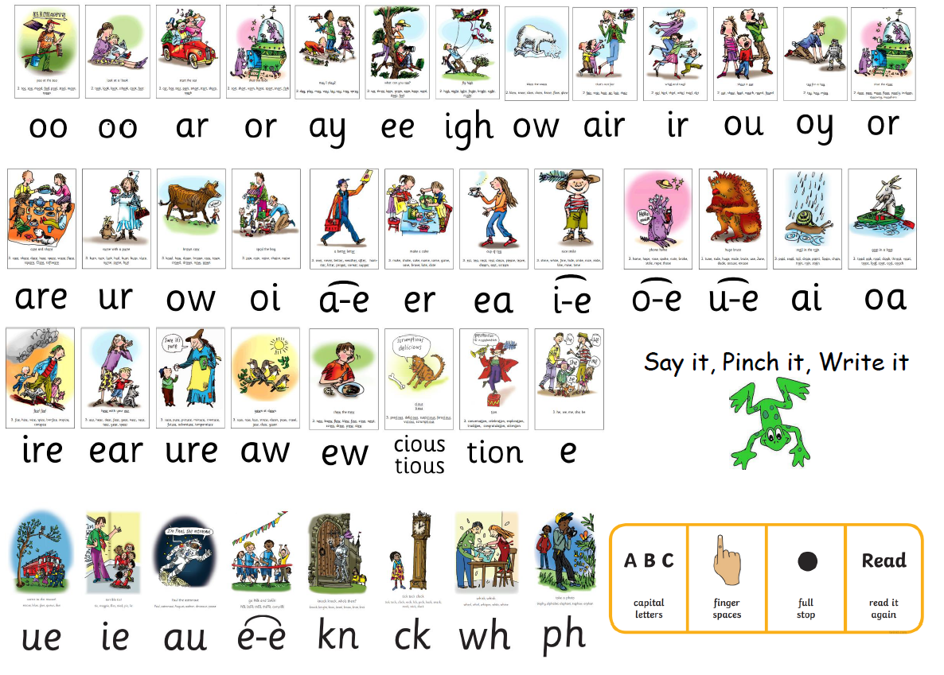
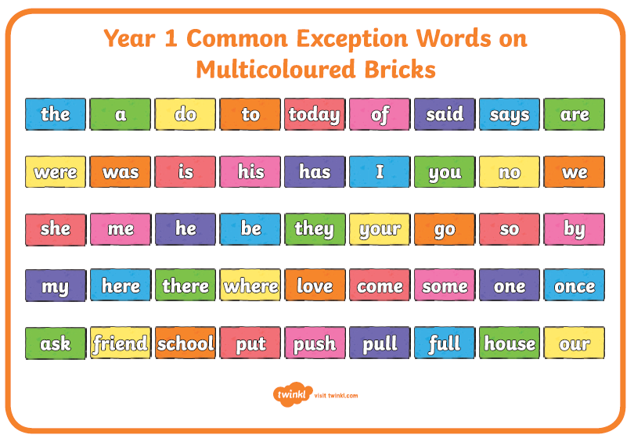
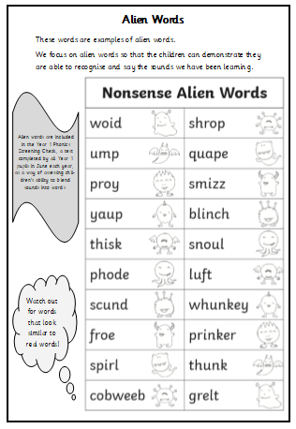
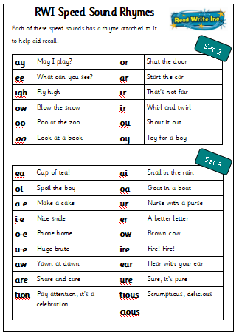
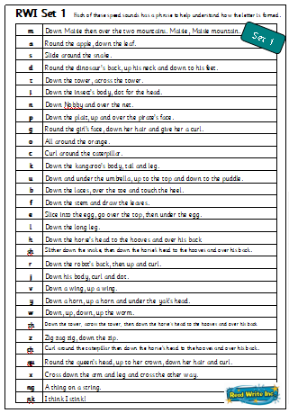
Reading information pack

Slide 5

Daily Read Write Inc. Sessions
(phonics)
We teach reading through phonics
Opens doors into reading
Systematic and repetitive
Enables ALL children to build confidence
Notes:
This is the programme that we use as a school to teach phonics. It’s a programme that opens the door into reading for many children. It’s systematic and repetitive which enables children to build confidence when word- reading.

Slide 6
What is phonics?
“Phonics is a way of teaching children how to read (and write). It helps children hear, identify and use different sounds that distinguish one word from another in the English language.” (National Literacy Trust)
‘tree’ is different to ‘play’
Phonics is a reliable strategy for teaching your child to read new vocabulary.

Slide 7
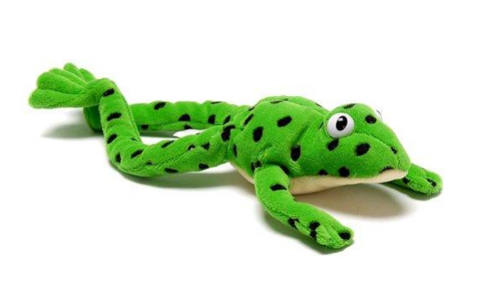

Fred Talk!
https://www.youtube.com/watch?v=dEzfpod5w_Q Ruth Miskin shows us how to blend sounds.

Slide 8
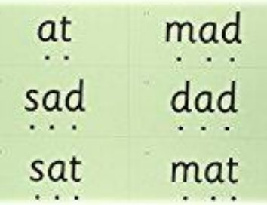
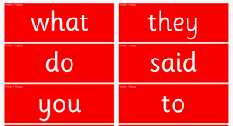
Green words
Red words (you can’t fred a red!)
Sound buttons
  shop chip play
Sound lines

Slide 9
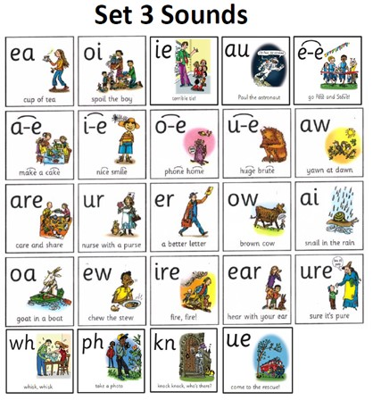
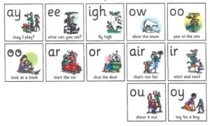
Set 2 sounds
Set 3 sounds
Two letters, one sound
‘special friends’

Slide 10
Split digraphs
Sounds are too chatty next to each other so their teacher split them up!
cake brute
home like

Slide 11

Supporting phonics at home
- Establish a routine to read together each day.
- Ask child about sounds they have learnt – practice together
- Can you tell me about this story?
- Look for special friends, Fred talk, read the word
- Can you show me some red words? (We can’t Fred a red!)

Slide 12
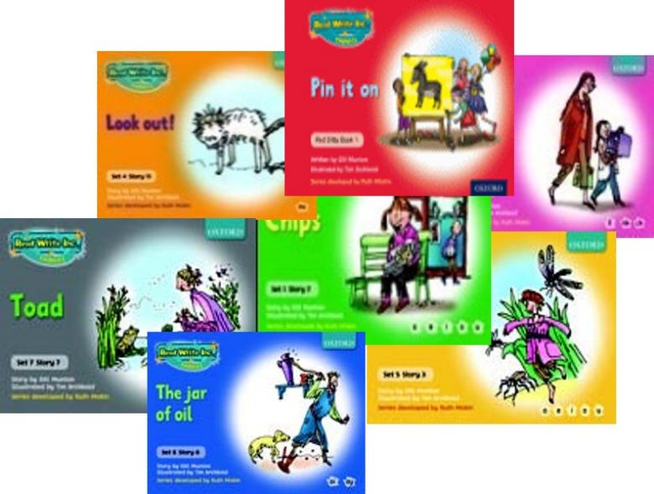
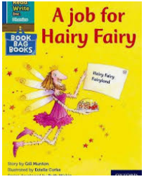
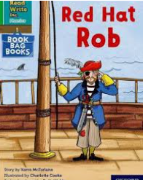

Changing Books
Monday
RWI book and Book Bag Book from previous week to go home
Friday
All books to be collected
Daily!

Slide 13
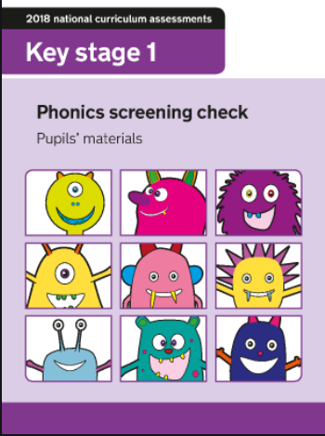
Phonics screener
National government assessment takes place every summer in year one
What is it?
- Takes place in Summer term (across country)
Assesses ability to use phonics as a strategy to read and checks if your child has retained appropriate amount of sounds for Year 2
Made up of 40 real words/pseudo (alien) words
Children do not know they are being tested.
1:1 with familiar adult
- If children do not pass they will have interventions in Y2 and retake in summer term of Y2

Slide 14

What does it
look like?
No sound buttons!
Words progressively
more challenging.

Slide 15
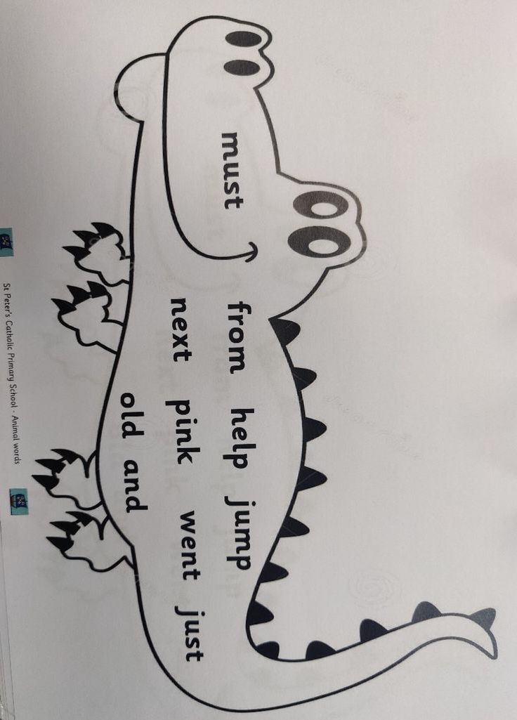
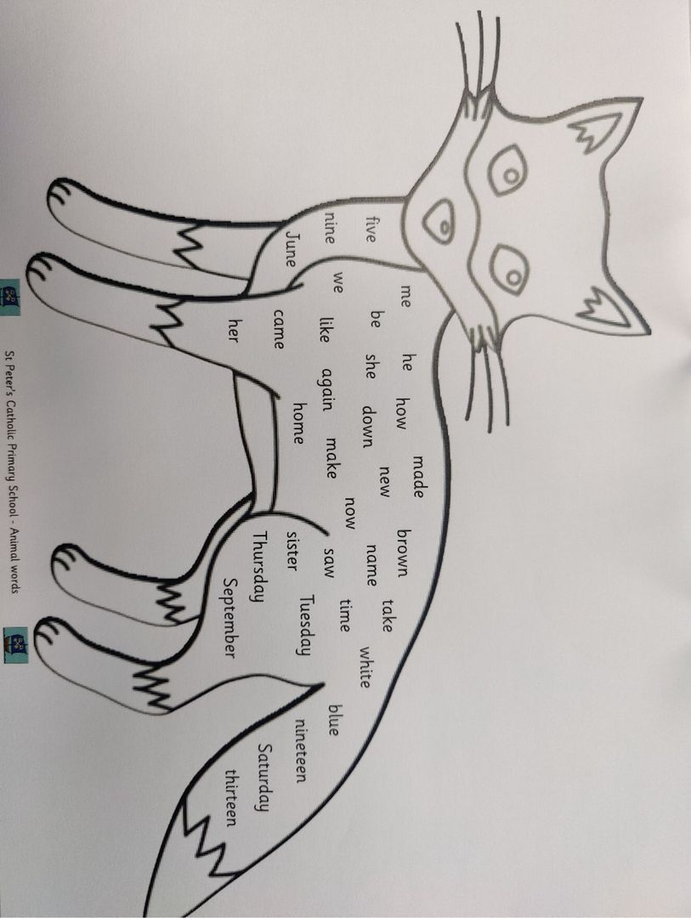
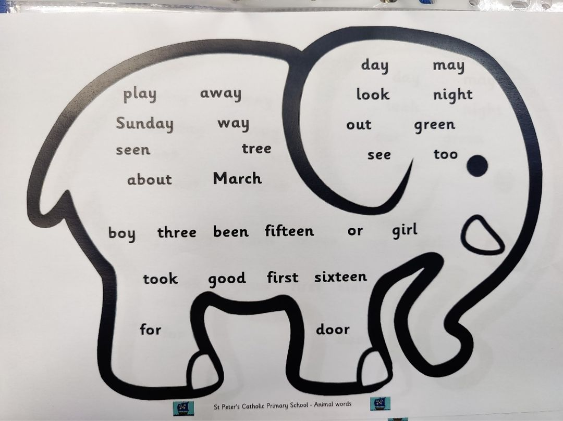
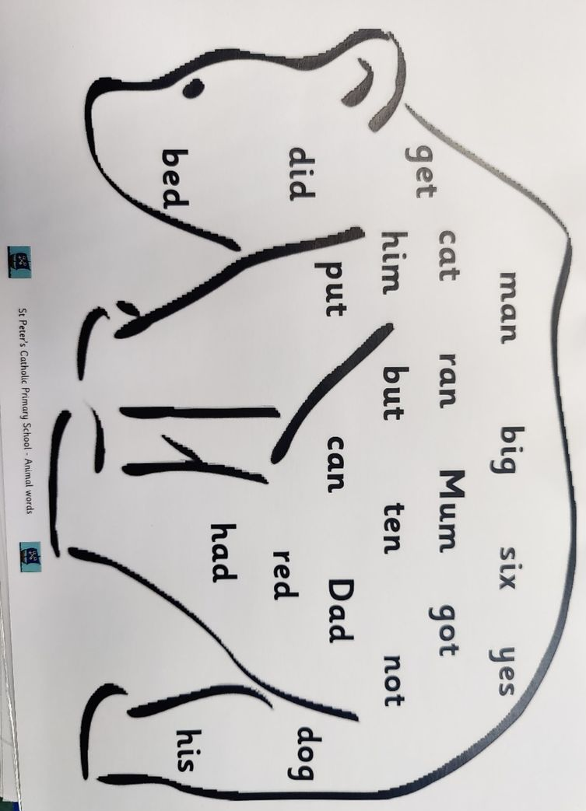
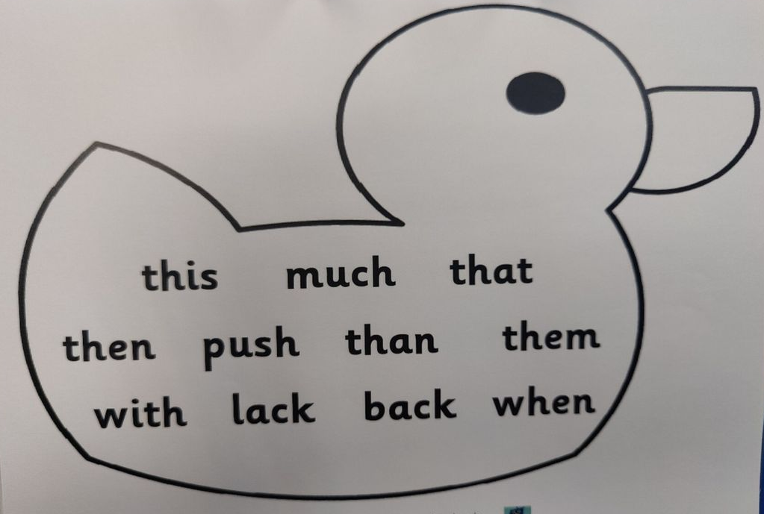
Animal words
Progressive
Opportunity to read together
Onus off reading whole book (2 or 3 mins)

Slide 16
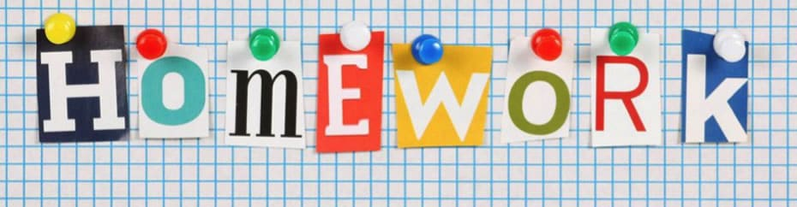
- Daily reading – celebration time!
- Animal words
- Weekly phonics words sent home to read together
- Share stories- read to your child for enjoyment

Slide 17
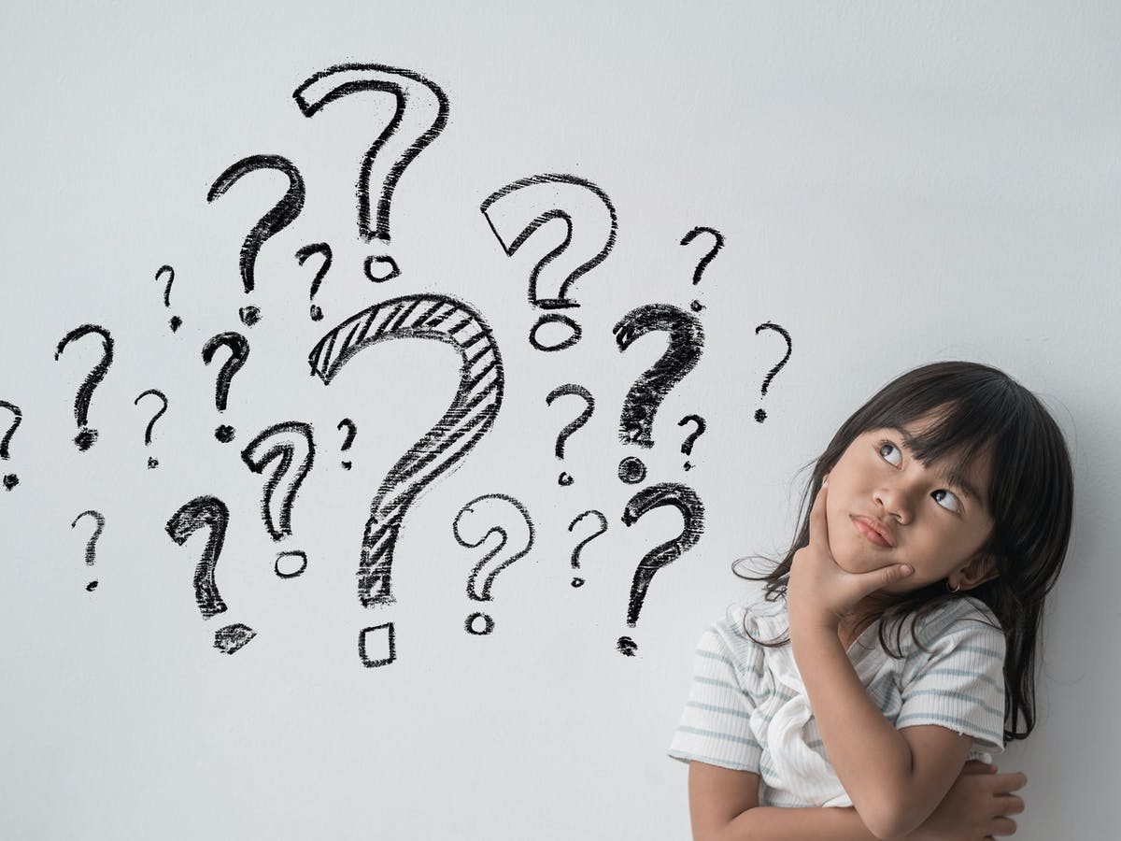
THANK YOU!
Any questions?

