Slide 2
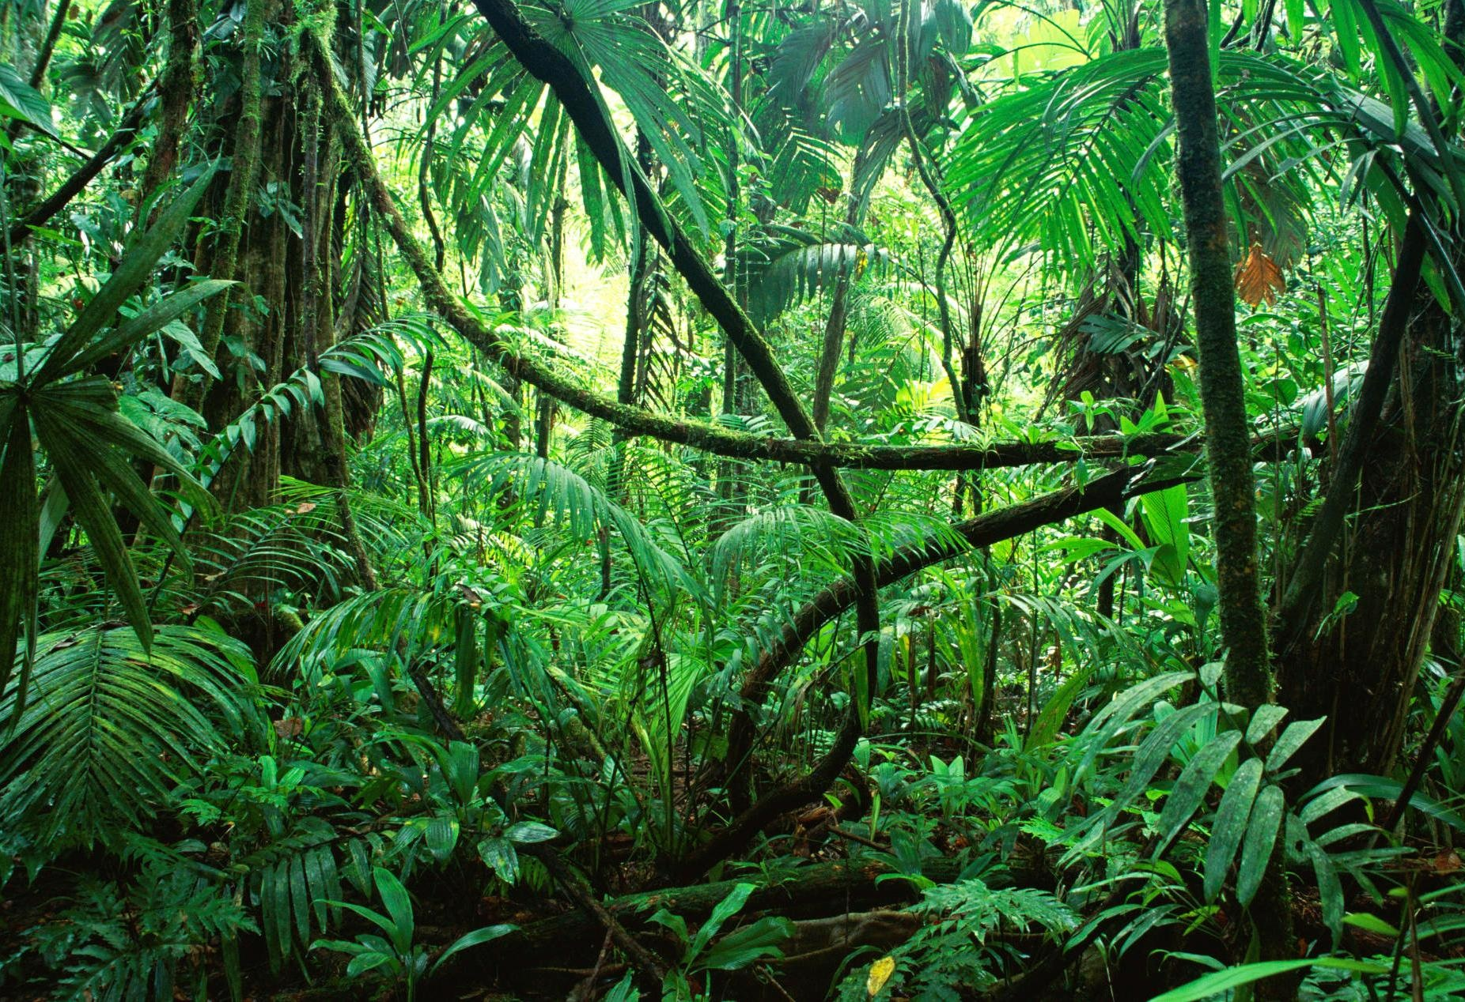
Over half the world’s types of plants and animals live in the jungle!
The jungle is very warm and very wet!

Slide 3
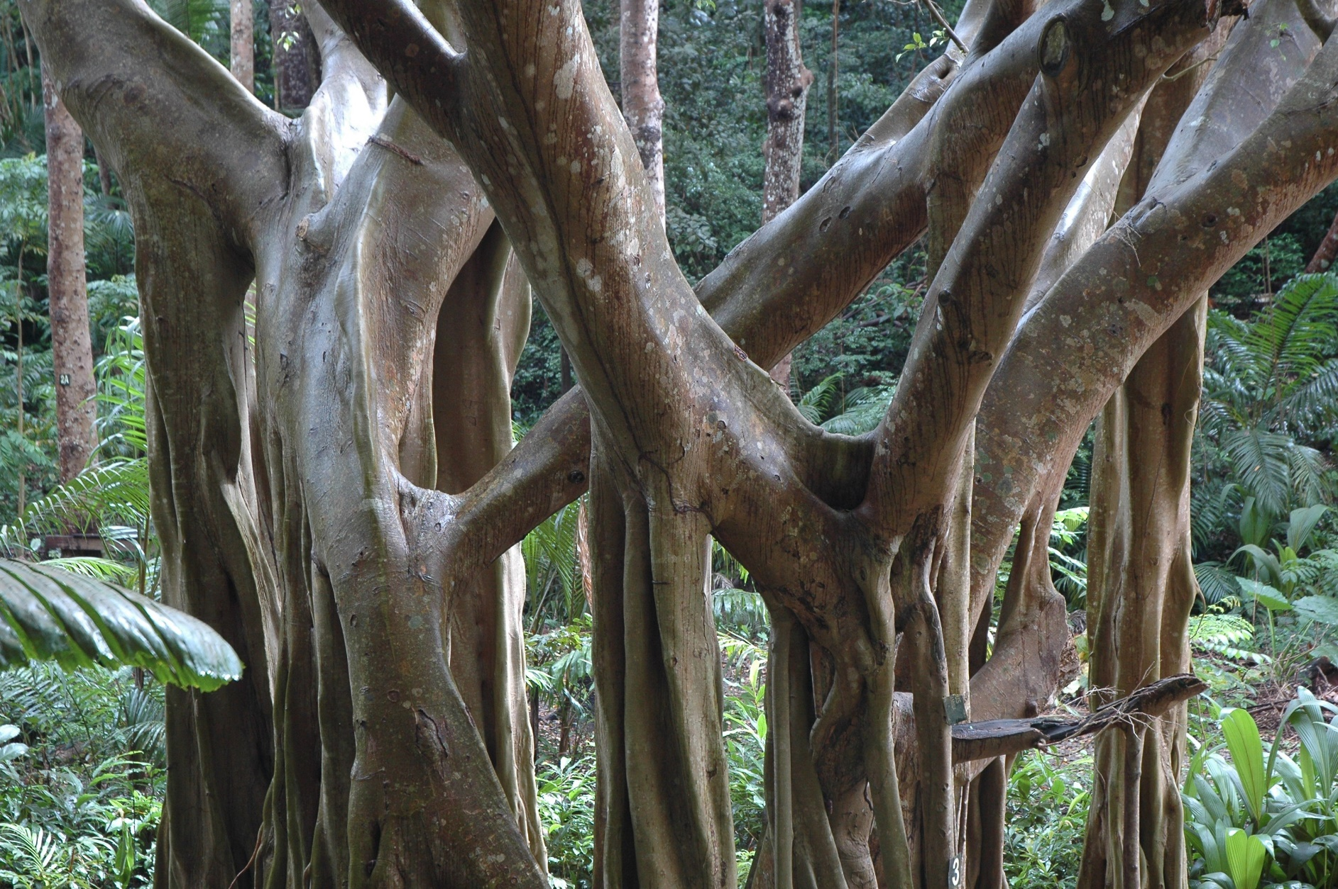
Jungles are overgrown with lots of tangled vegetation and dense forest!
Thousands of insects live in one jungle tree!

Slide 4
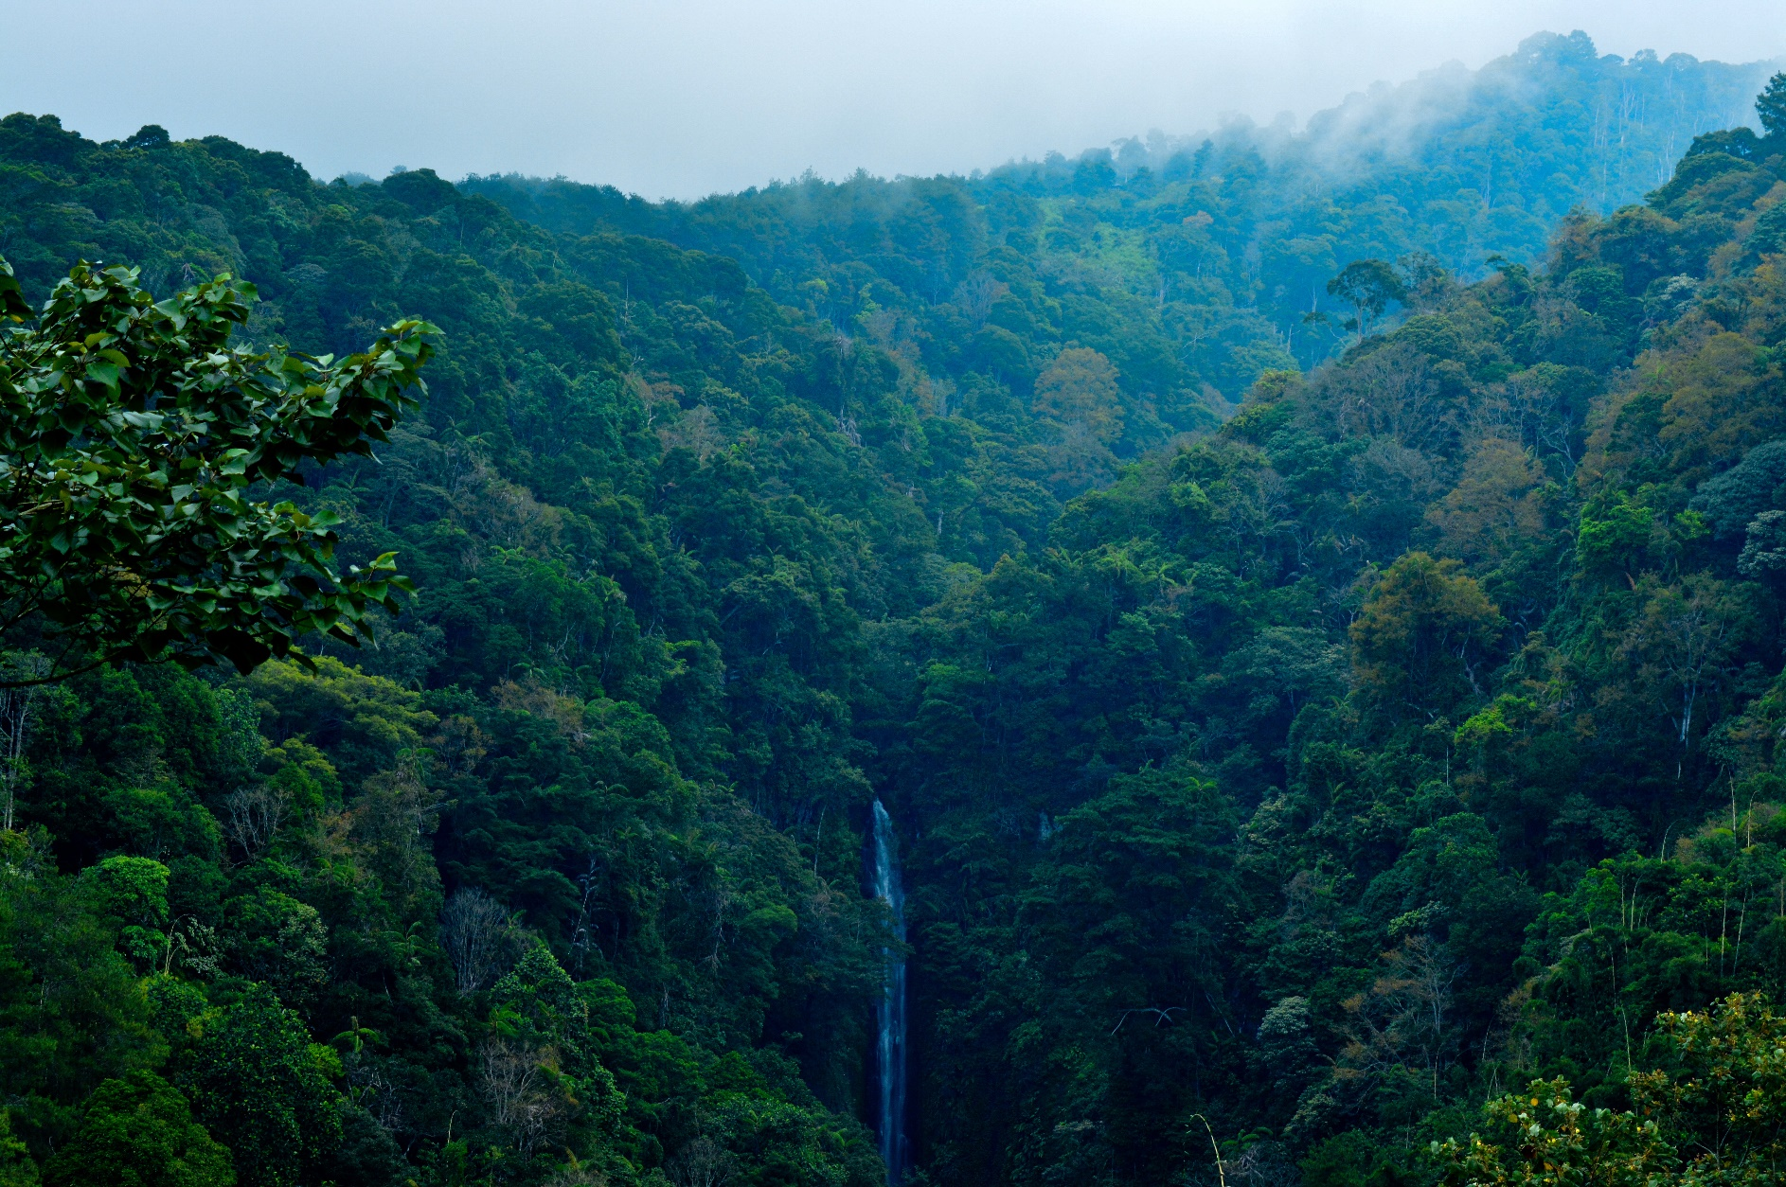
The trees are very tall in the rainforest, so the ground underneath them doesn’t get very much sunlight. Not many plants grow on the floor without sunlight.

Slide 5
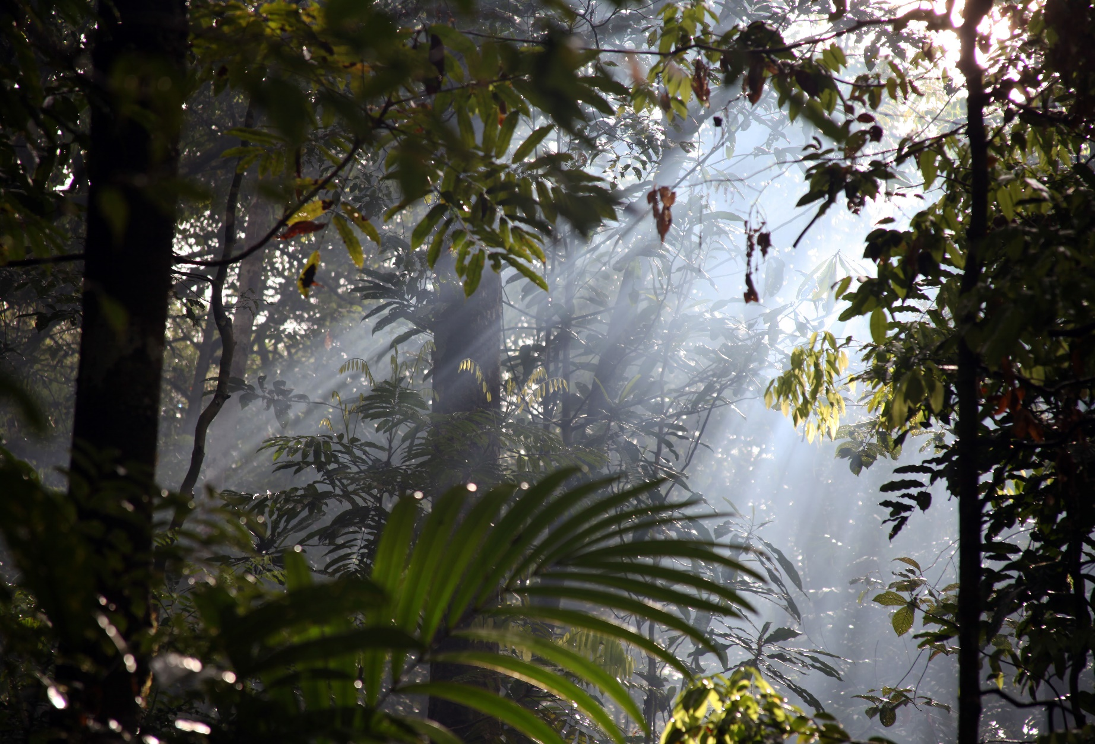
There are lots of plants and animals in the jungle that have never been discovered!
The jungle is very dark. Only 1% of the jungle has sunlight because of the shade from the trees!
“Streams of light in the Amazonian mist” by Jon Rawlinson is licensed under CC BY 2.0

Slide 6
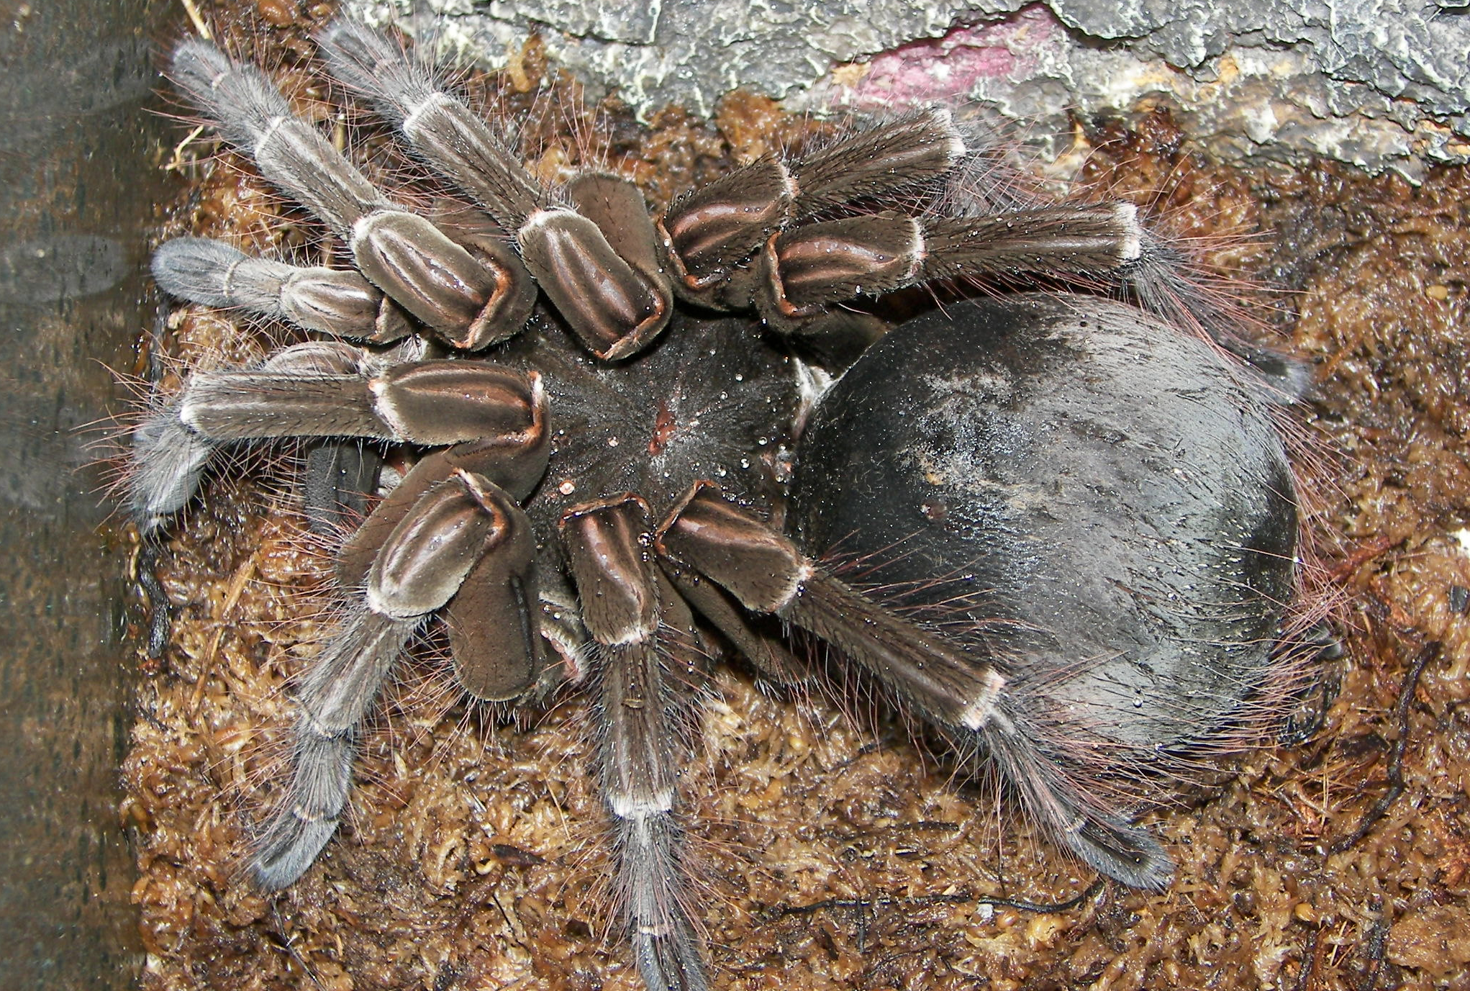
Bird eating spiders in the Amazon Rainforest can grow as big as dinner plates!
“Theraphosa blondi” by ‘John’ is licensed under CC BY 2.0

Slide 7
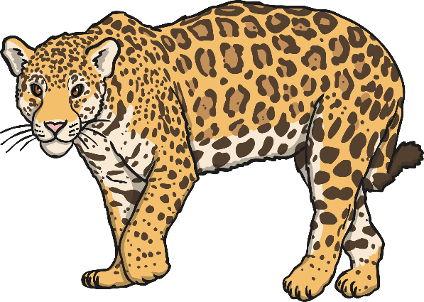
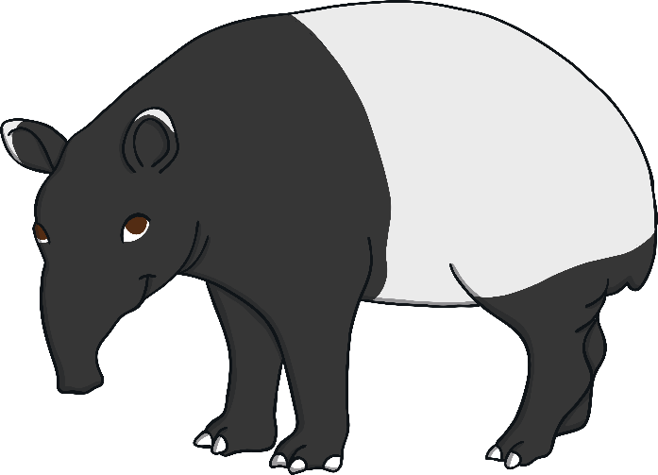

Jungle Animals in the Amazon Rainforest
Jaguars
Tapirs
Capybara (the world’s biggest rodent)
Anacondas
Poison dart frogs
Spider monkeys
Howler monkeys
Piranhas
Bird eating spiders

Slide 8

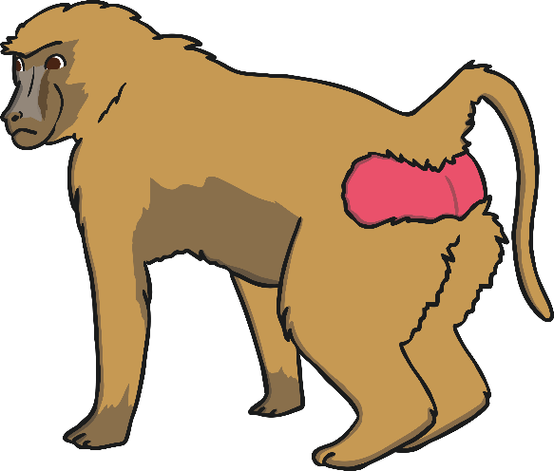
Jungle Animals in Africa
Leopards
Jungle elephants
Nile crocodiles
Grey parrots
Chimpanzees
Gorillas
Baboons
Termites

Slide 9
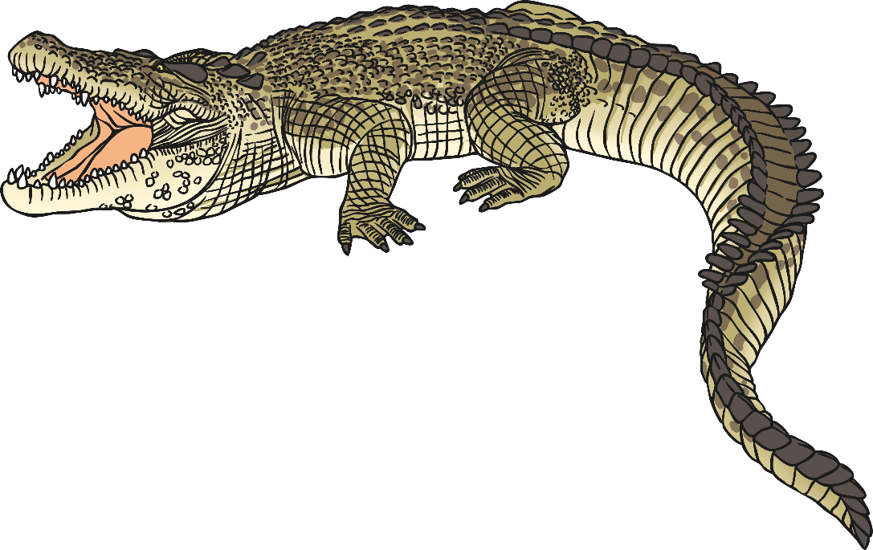
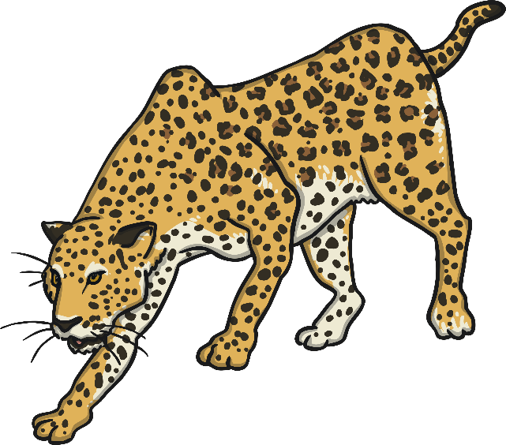
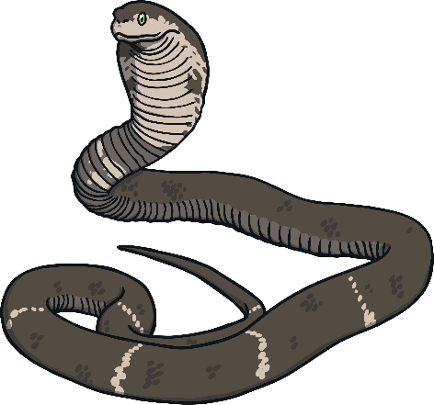
Jungle Animals in Asia
Tigers
Leopards
Bears
Fruit Bats
Elephants
Water Buffalos
Cockatoos
Saltwater Crocodiles
Cobras
Orang-utan

Slide 10
What are the tops of the jungle trees called?
What is your favourite jungle animal?
Is the jungle dark or light?
What is the weather like in the jungle?

