Slide 2

Where in the World?
The United Kingdom
is made up of England, Scotland, Wales and Northern Ireland. It is in the Atlantic Ocean.
The United States of America is across the Atlantic Ocean from the UK, in North America in-between Canada to the north and Mexico to the south.

Slide 3
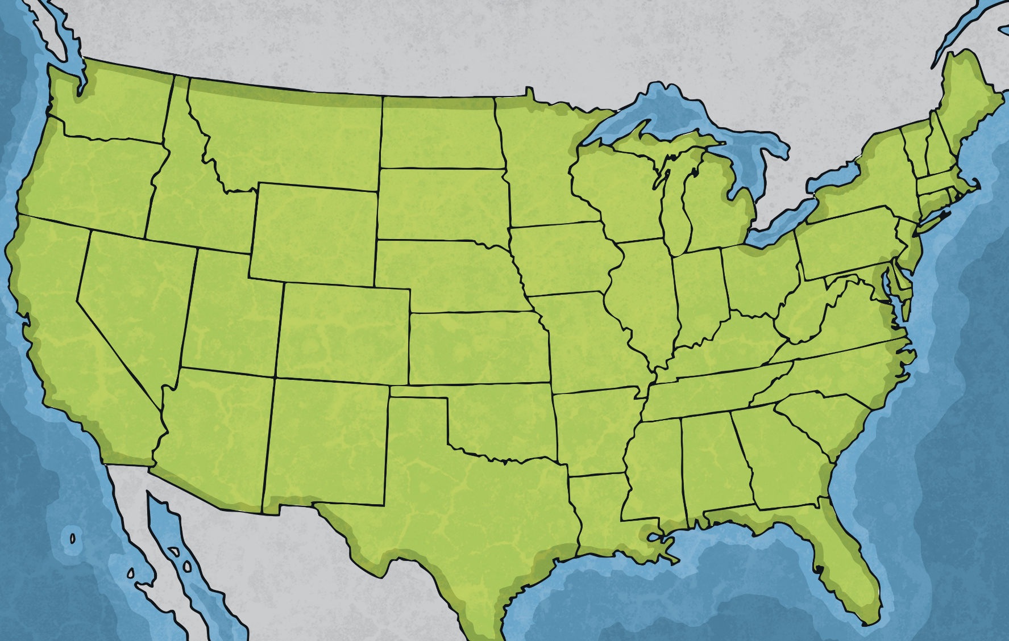
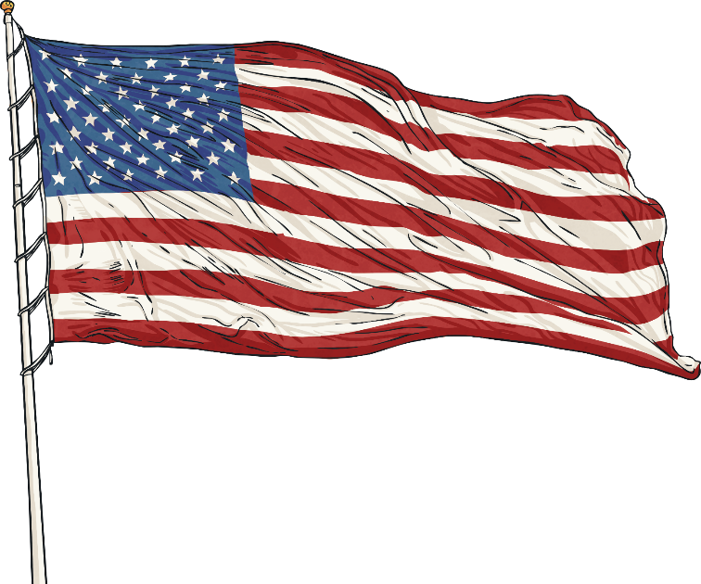
The United States
It is called the United States of America because the country is split into fifty different states (a bit like the counties we have in England).
Flag Fact: There are fifty stars on the US flag representing the fifty states.

Slide 4
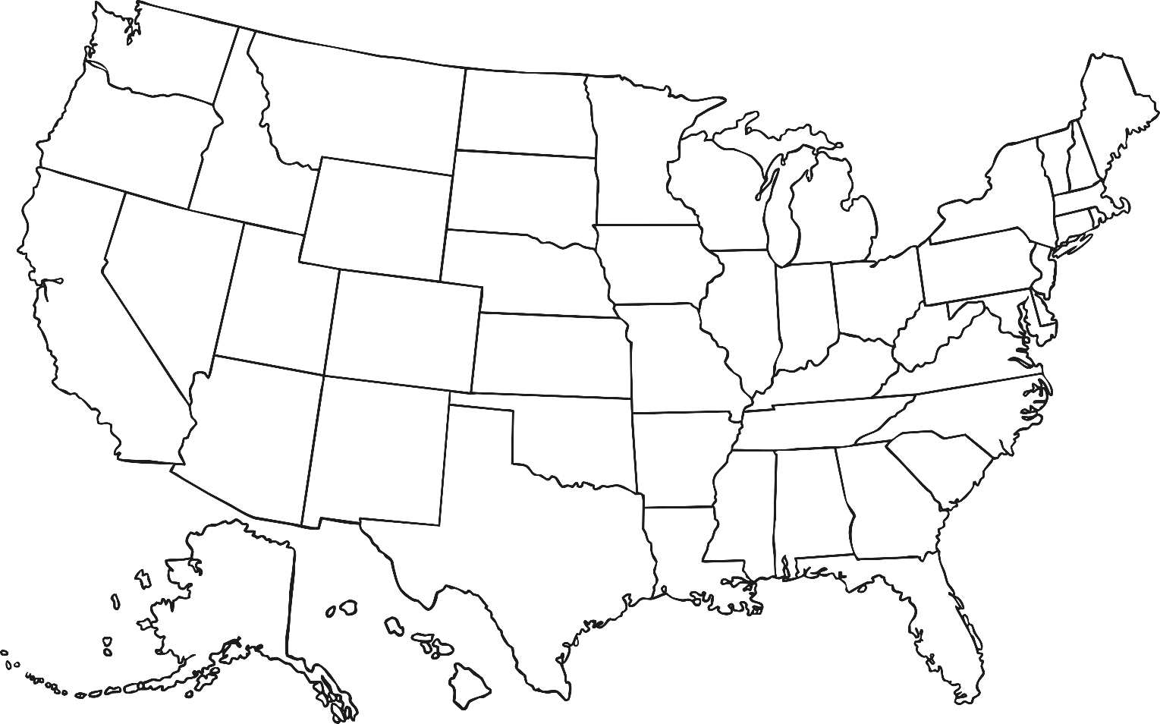
The United States
Each state has an abbreviation, such as TX for Texas (a bit like UK postcodes). Why not have a go at identifying them all?
WA
MT
ND
VT
ME
OR
MN
NH
ID
MA
SD
WI
NY
WY
MI
RI
NE
IA
PA
CT
NV
UT
OH
NJ
CA
IL
IN
DE
CO
WV
KS
MO
KY
VA
MD
D.C
Hawaii (HI) is over 2500 miles west of California and about the same distance south of Alaska!
TN
NC
AZ
NM
OK
AR
SC
AL
GA
TX
LA
MS
FL

Slide 5
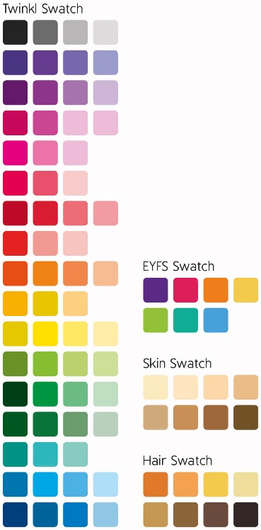
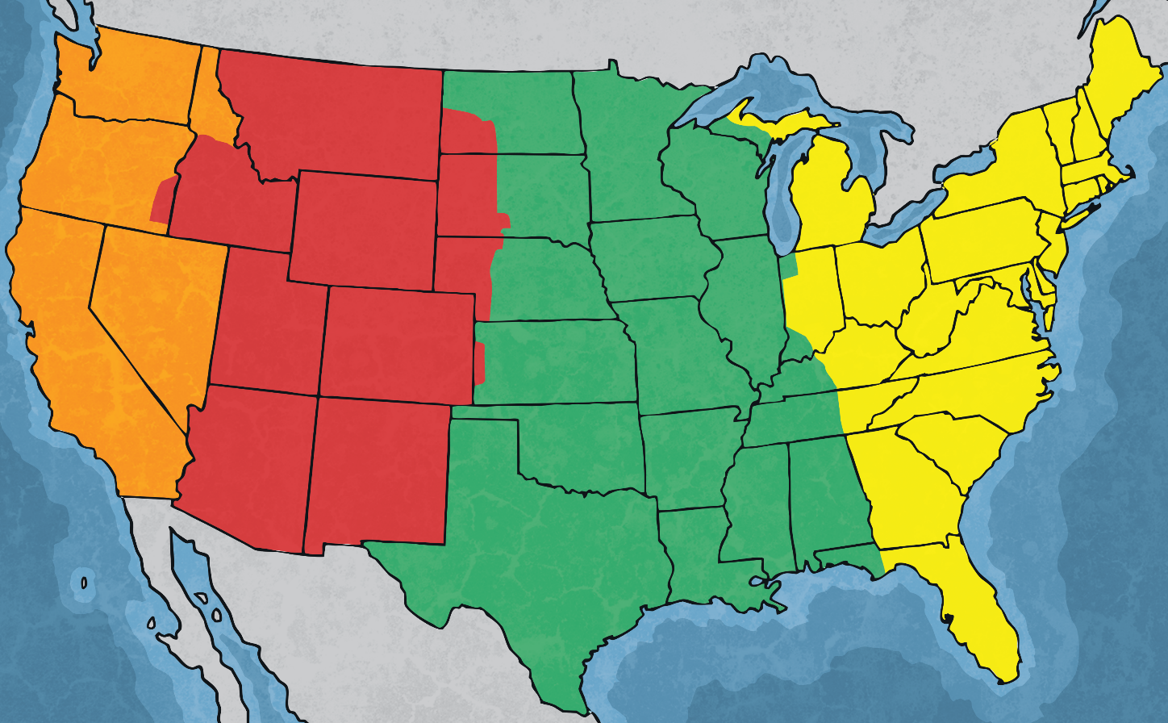
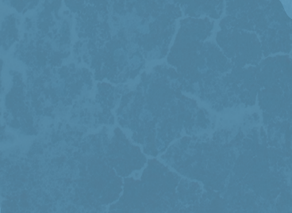
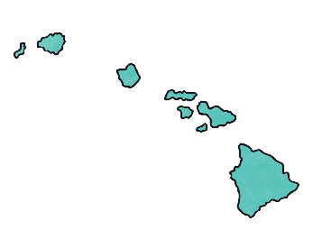

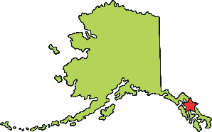
Time Zones
The large distance between the two countries means they are in different time zones. The USA is so vast that some states aren’t in the same time zones.
Hawaiian Time Zone
(UK Time - 10 hours)
Mountain Time Zone
(UK Time - 7 hours)
Pacific Time Zone
(UK Time - 8 hours)
Eastern Time Zone
(UK Time - 5 hours)
Alaskan Time Zone
(UK Time - 9 hours)
Central Time Zone
(UK Time - 6 hours)
Both the UK and USA have daylight saving times during the summer.

Slide 6
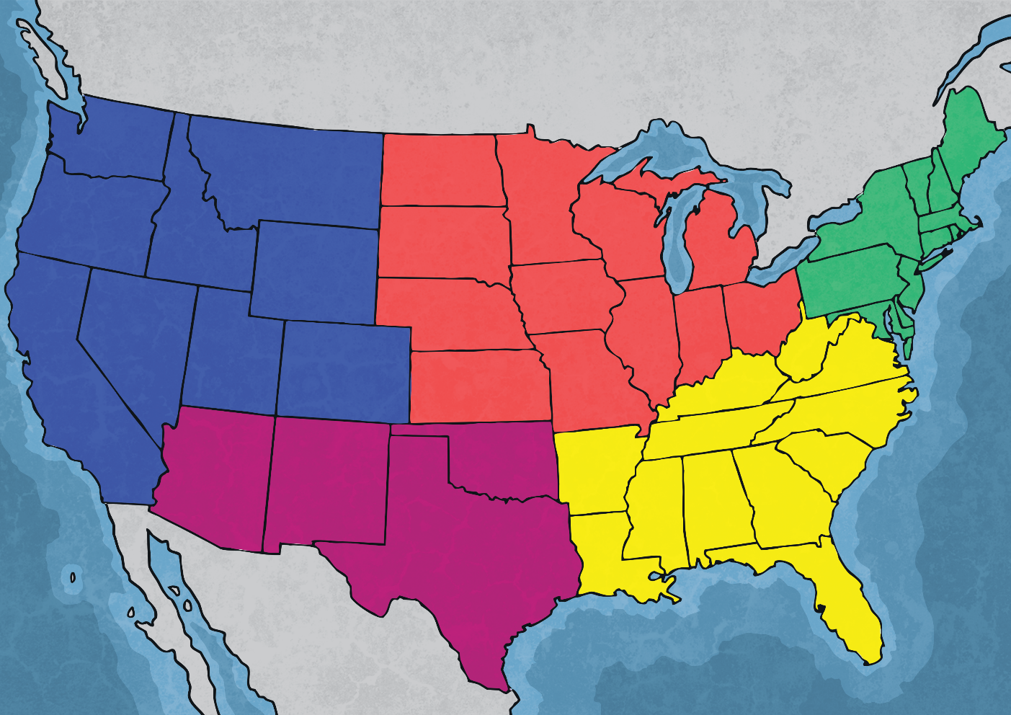
Climates in the USA
Like the UK, the USA is in the northern hemisphere and experience the seasons at the same time as us in the UK. However, the USA is so vast that it covers a range of different climate zones called regional climates.
The mid/south Pacific is variable as states such as California are warm all year round whilst others have very cold winters.
The mid-west has clear seasons like the north-east but is generally drier.
The north-east has clear seasons with warm summers and cold, snowy and icy winters.
The south-west is the hottest climate zone in the USA and can include thunderstorms and tornadoes.
The south-east is hot and dry in summer and mild in winter although snow can sometimes fall.

Slide 7
Extreme Weather and Natural Disasters
Earthquakes
The San Andreas Fault is a line down the west coast of the USA where two tectonic plates meet making it a high-risk area for earthquakes.
MT
ND
VT
ME
OR
Tornadoes occur in ‘Tornado Alley’, covering Kansas, Missouri, Nebraska, Iowa and South Dakota.
ID
MN
NH
SD
WI
NY
MA
WY
MI
RI
NE
IA
PA
CT
NV
UT
OH
NJ
CA
IL
IN
DE
Fires and droughts are a threat during hotter months in the hotter states, such as Arizona.
CO
WV
KS
MO
KY
VA
MD
D.C
Monsoons happen most often in the south-west states.
AZ
TN
NC
NM
OK
AR
SC
AL
GA
TX
LA
MS
Volcanoes are most prevalent in Hawaii and Alaska. There are actually 169 active volcanoes in the USA.
Floods are becoming more common and widespread but most are towards the south-east states.
FL

Slide 8
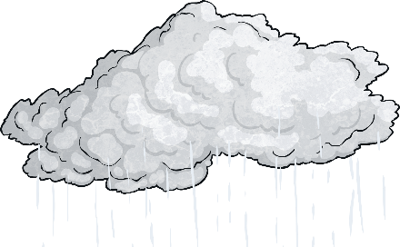





Climate in the UK
Compared to the USA, the UK is so small that it has the same climate everywhere, although it is often a bit warmer the further south you go.
The UK has warm summers and cool winters. Summers are
cooler than others in Europe but winters are milder.
July and August are the warmest months in the UK.
January and February are the coldest months.
The west of the UK is the wettest.
It rains throughout the year.
Average
Temperature:
9.3°C

Slide 9
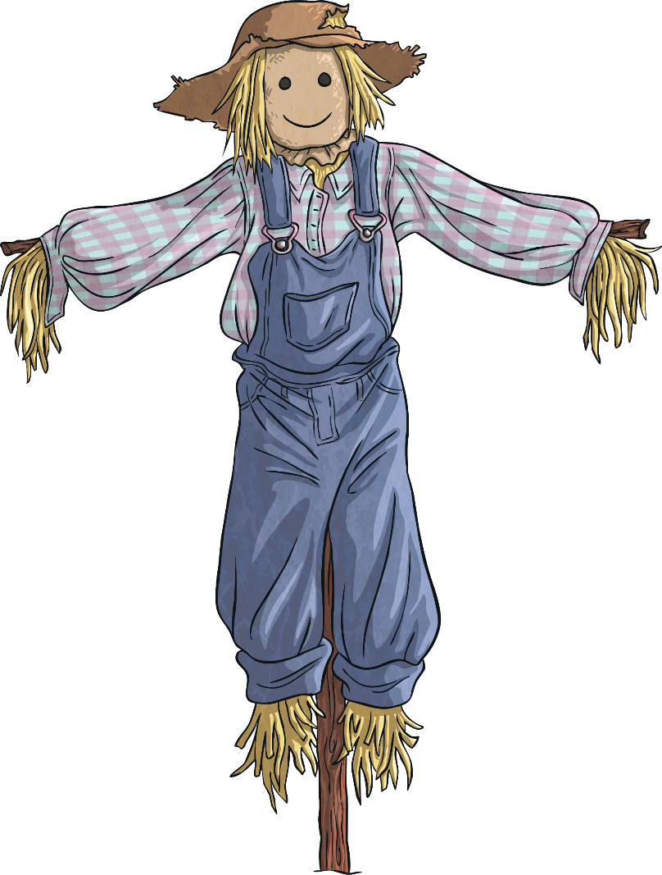



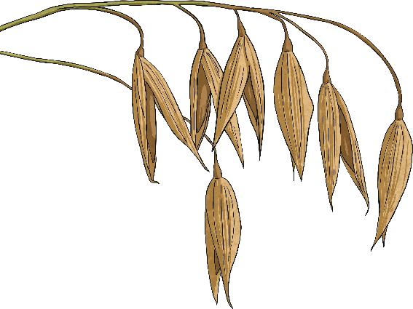
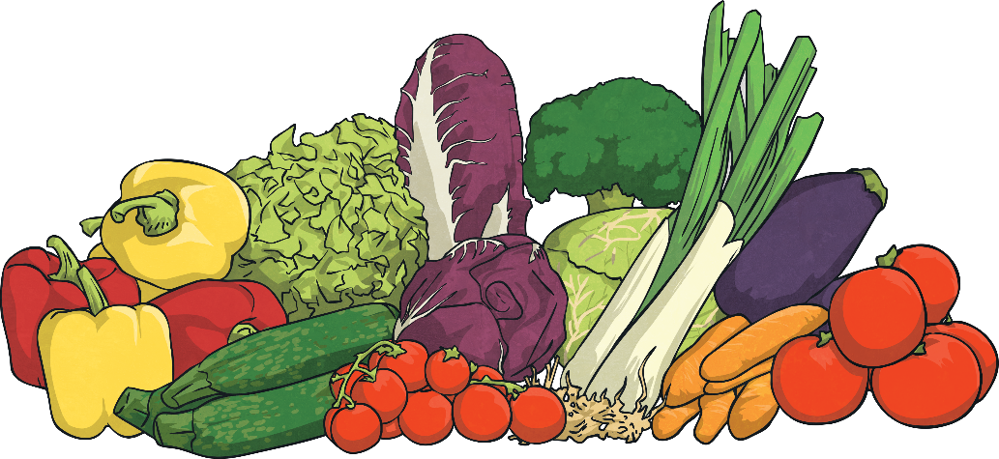
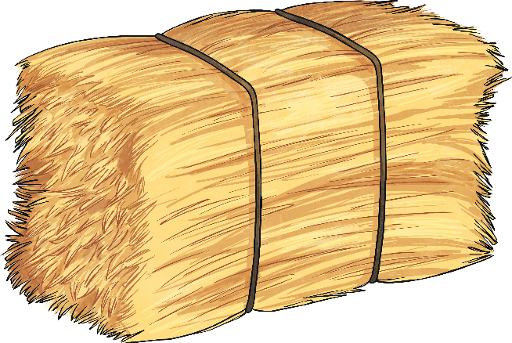
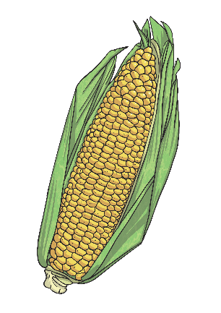
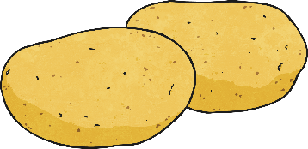
Crops
Grown in the UK
Grown in the USA
wheat
barley
oats
potatoes
sugar beet
vegetables
oilseed rape
corn
soya beans
wheat
alfalfa
cotton
hay

Slide 10
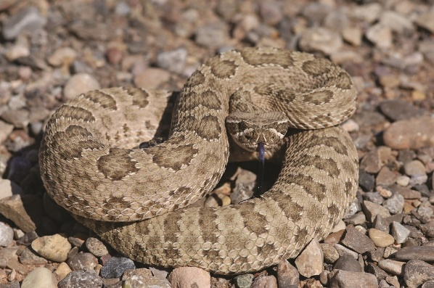
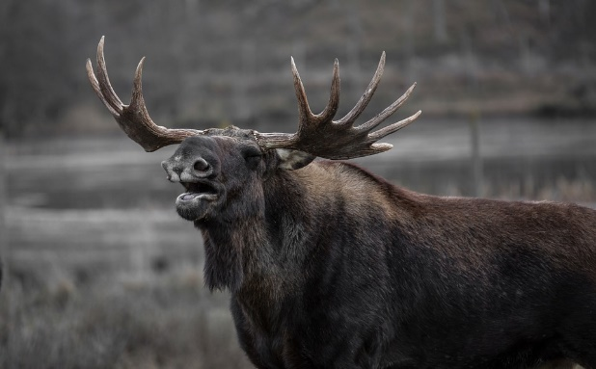
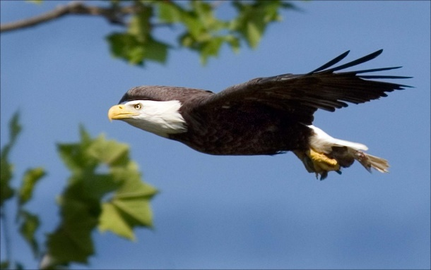
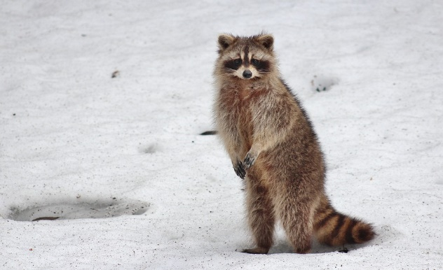
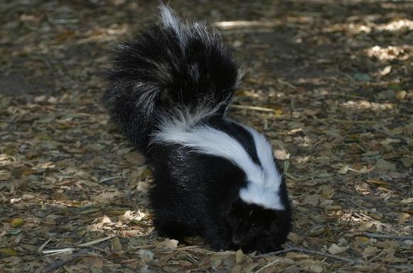
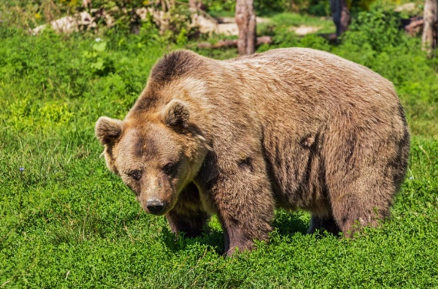
American Animals
Look at these picture of animals from the USA. Can you name them all?
eagle
rattlesnake
?
?
moose
?
racoon
?
skunk
?
brown bear
?
Notes:
10

Slide 11
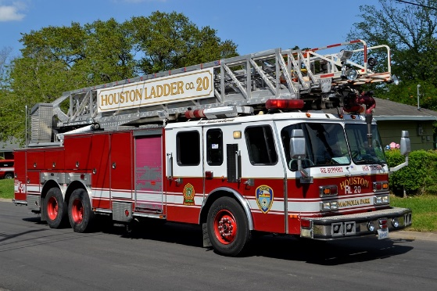
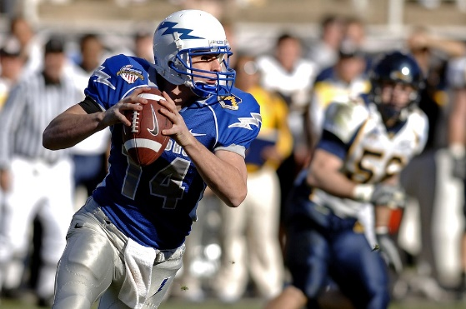
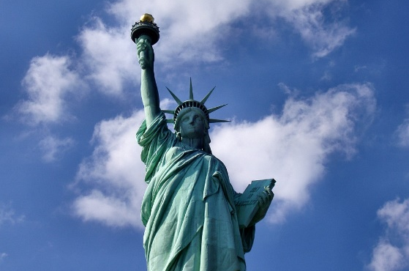

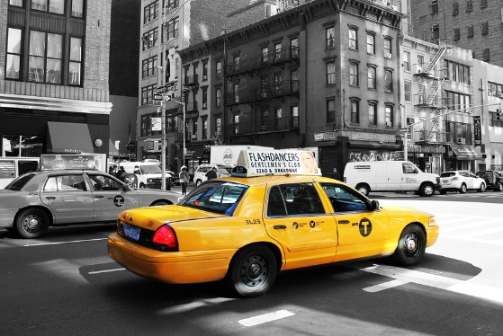

Life in the USA
Look at these pictures of life in the USA and compare them to what you know about the UK.
Notes:
11

Slide 12
English Words
English is the most common language in both countries, but there are some differences between UK English and US English. Can you guess the hidden words below?
rubbish
?
trainers
?
holidays
trash
sneakers
vacation
?
car bonnet
tap
?
pavement
?
hood
?
faucet
sidewalk
car boot
jam
?
car fuel
trunk
?
jelly
gas
?
Notes:
12

