Slide 2
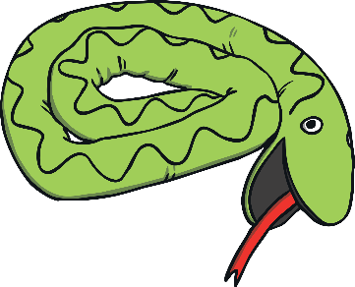

toy
Use Timer
Show Answer
Start Timer
Start Timer
Next

Slide 3
bloy
Start Timer
Start Timer
Next
Use Timer
Show Answer

Slide 4
zoy
Start Timer
Show Answer
Start Timer
Use Timer
Next

Slide 5
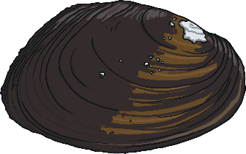
oyster
Start Timer
Start Timer
Use Timer
Show Answer
Next

Slide 6
doyst
Start Timer
Show Answer
Start Timer
Use Timer
Next

Slide 7

boy
Start Timer
Start Timer
Use Timer
Show Answer
Next

Slide 8
koy
Start Timer
Show Answer
Start Timer
Use Timer
Next

Slide 9
loyag
Start Timer
Show Answer
Start Timer
Use Timer
Next

Slide 10
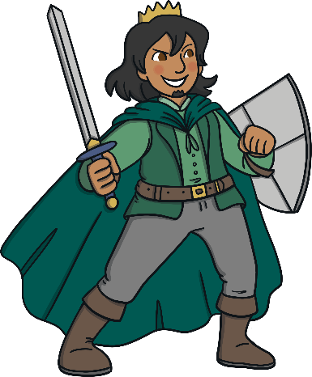
royal
Start Timer
Start Timer
Use Timer
Show Answer
Next

Slide 11


enjoy
Start Timer
Start Timer
Use Timer
Show Answer
Next

Slide 12
voyp
Start Timer
Show Answer
Start Timer
Use Timer
Next

Slide 13

soy
Start Timer
Start Timer
Use Timer
Show Answer
Next

Slide 14
denoy
Start Timer
Show Answer
Start Timer
Use Timer
Next

Slide 15
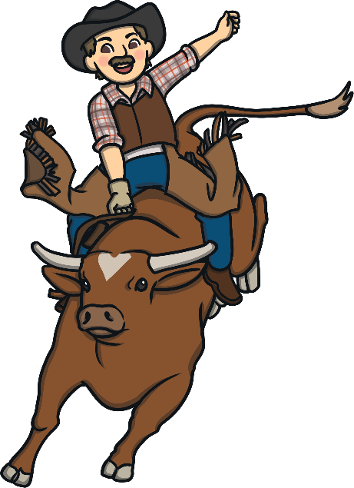
cowboy
Start Timer
Start Timer
Use Timer
Show Answer
Next

Slide 16

joy
Start Timer
Start Timer
Use Timer
Show Answer
Next

Slide 17
floy
Start Timer
Show Answer
Start Timer
Use Timer
Next

