Slide 2


found
Start Timer
Start Timer
Next
Use Timer
Show Answer

Slide 3
plound
Start Timer
Show Answer
Start Timer
Use Timer
Next

Slide 4
frout
Start Timer
Show Answer
Start Timer
Use Timer
Next

Slide 5

cloud
Start Timer
Start Timer
Next
Use Timer
Show Answer

Slide 6

sprout
Start Timer
Start Timer
Next
Use Timer
Show Answer

Slide 7
hount
Start Timer
Show Answer
Start Timer
Use Timer
Next

Slide 8
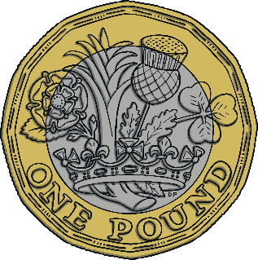
pound
Start Timer
Start Timer
Next
Use Timer
Show Answer

Slide 9
glout
Start Timer
Show Answer
Start Timer
Use Timer
Next

Slide 10
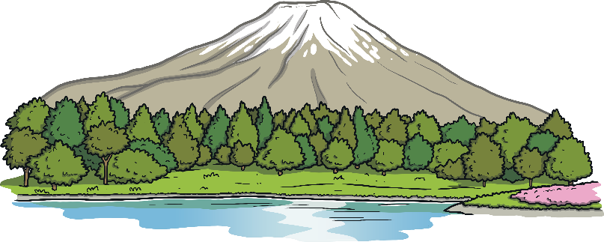
mount
Start Timer
Start Timer
Next
Use Timer
Show Answer

Slide 11
about
Start Timer
Start Timer
Next
Use Timer
Show Answer

