Slide 2
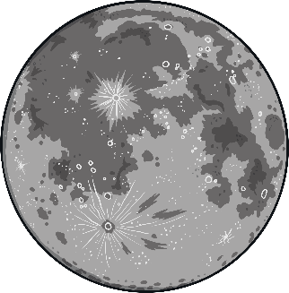

moon
Start Timer
Start Timer
Use Timer
Show Answer
Next

Slide 3
thoon
Start Timer
Show Answer
Start Timer
Use Timer
Next

Slide 4
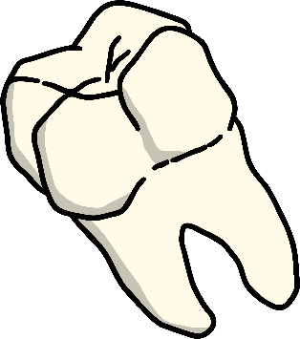
tooth
Start Timer
Start Timer
Use Timer
Show Answer
Next

Slide 5
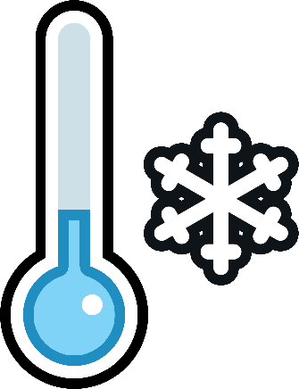
cool
Start Timer
Start Timer
Use Timer
Show Answer
Next

Slide 6
roop
Start Timer
Show Answer
Start Timer
Use Timer
Next

Slide 7
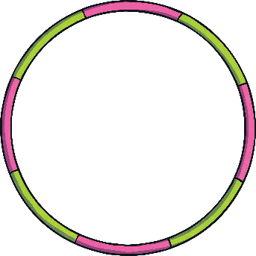
hoop
Start Timer
Start Timer
Use Timer
Show Answer
Next

Slide 8
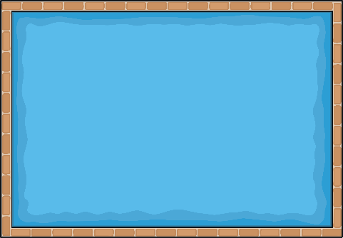
pool
Start Timer
Start Timer
Use Timer
Show Answer
Next

Slide 9
shoom
Start Timer
Show Answer
Start Timer
Use Timer
Next

Slide 10
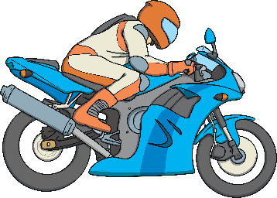
zoom
Start Timer
Start Timer
Use Timer
Show Answer
Next

Slide 11
quooth
Start Timer
Show Answer
Start Timer
Use Timer
Next

