Slide 2


seed
Start Timer
Start Timer
Use Timer
Show Answer
Next

Slide 3

bee
Start Timer
Start Timer
Use Timer
Show Answer
Next

Slide 4
theen
Start Timer
Start Timer
Show Answer
Use Timer
Next

Slide 5
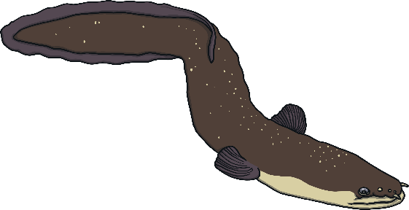
eel
Start Timer
Start Timer
Use Timer
Show Answer
Next

Slide 6

cheek
Start Timer
Start Timer
Use Timer
Show Answer
Next

Slide 7
weesh
Start Timer
Start Timer
Show Answer
Use Timer
Next

Slide 8
beel
Start Timer
Start Timer
Show Answer
Use Timer
Next

Slide 9
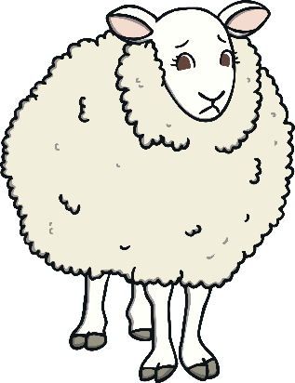
sheep
Start Timer
Start Timer
Use Timer
Show Answer
Next

Slide 10
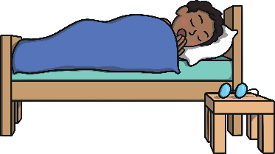
sleep
Start Timer
Start Timer
Use Timer
Show Answer
Next

Slide 11
jeeth
Start Timer
Start Timer
Show Answer
Use Timer
Next

