Slide 2
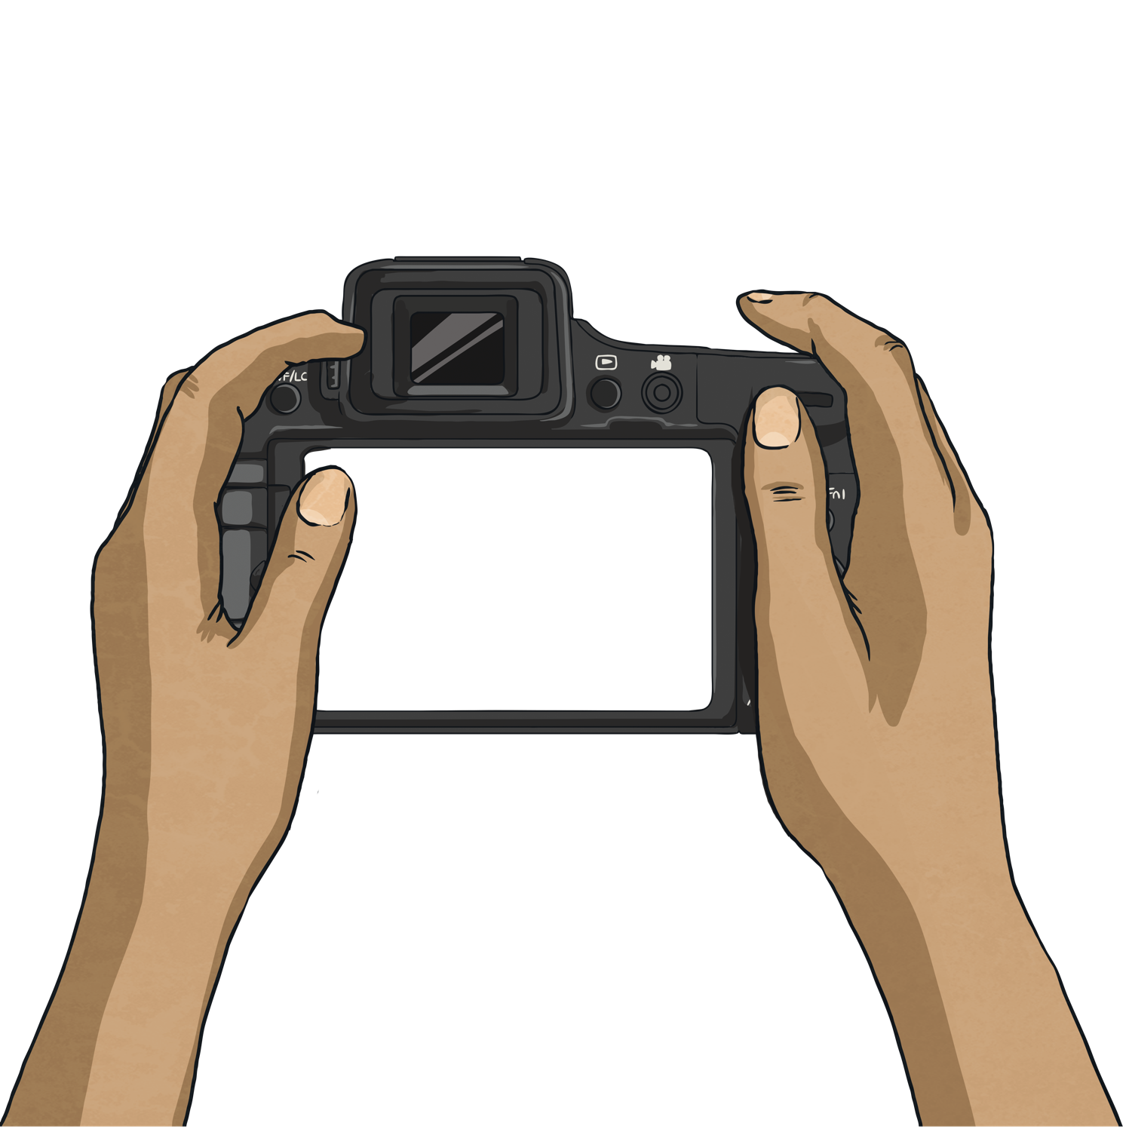
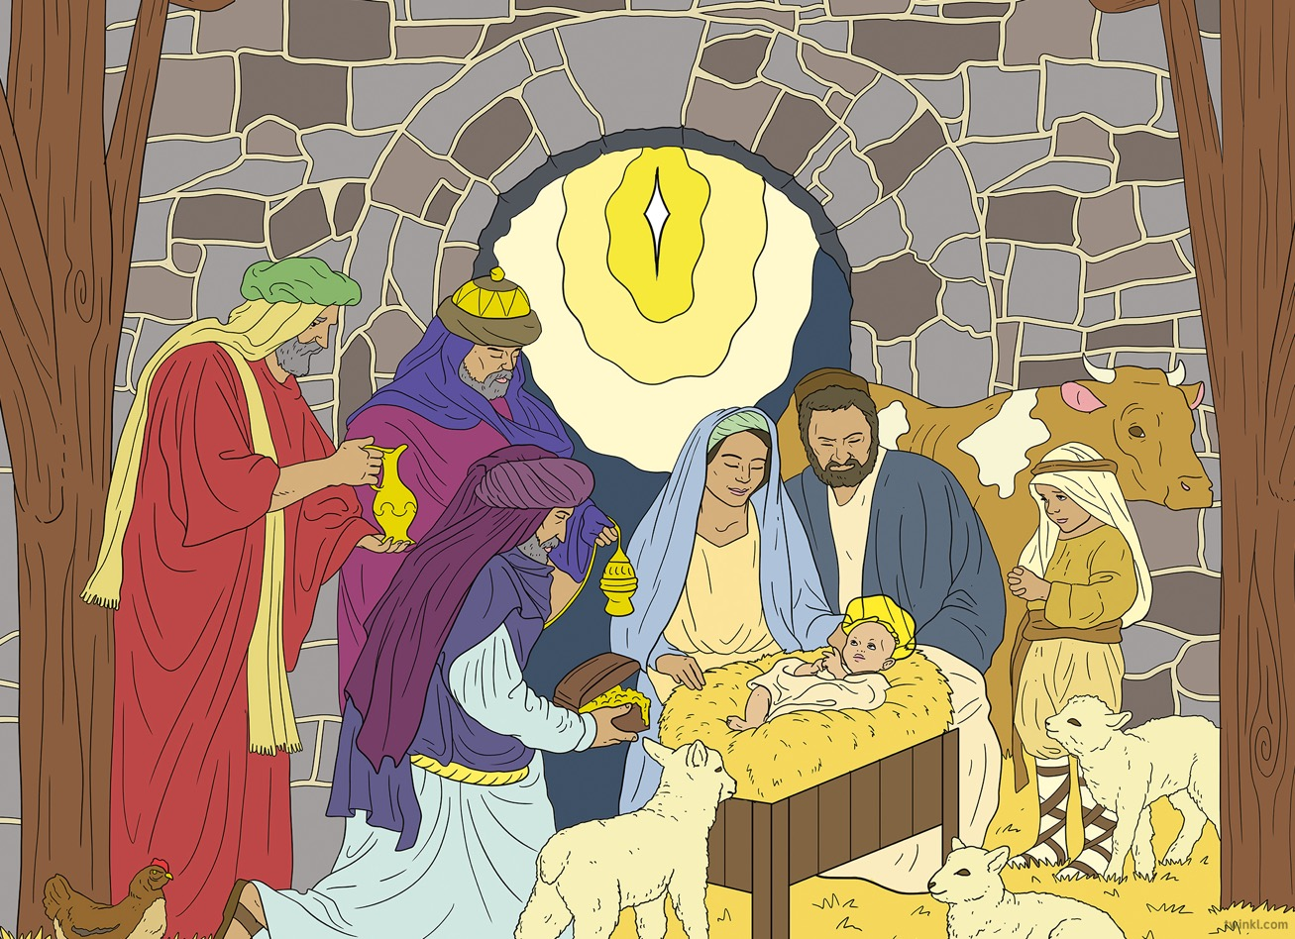
What do you think?
What can you see?
What do you wonder?

Slide 3

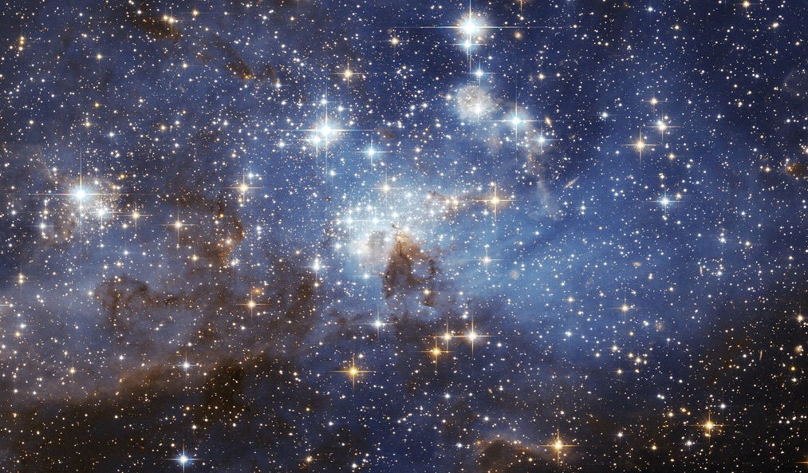
“StarsInTheSky” by Bambosz is licensed under CC BY 2.0

Slide 4
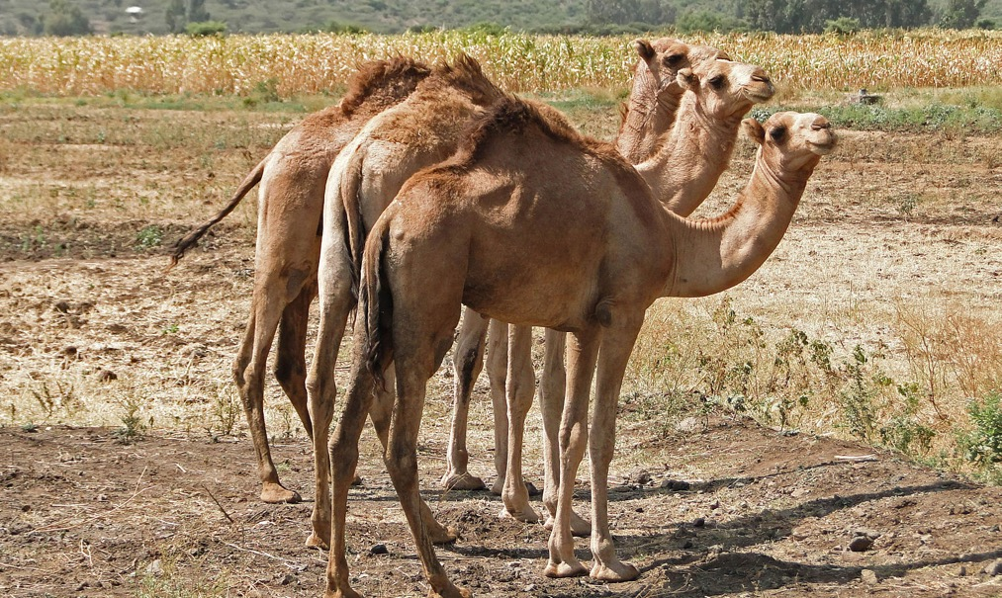
“Camels in Ethiopia” by Bernard Gagnon is licensed under CC BY 2.0

Slide 5
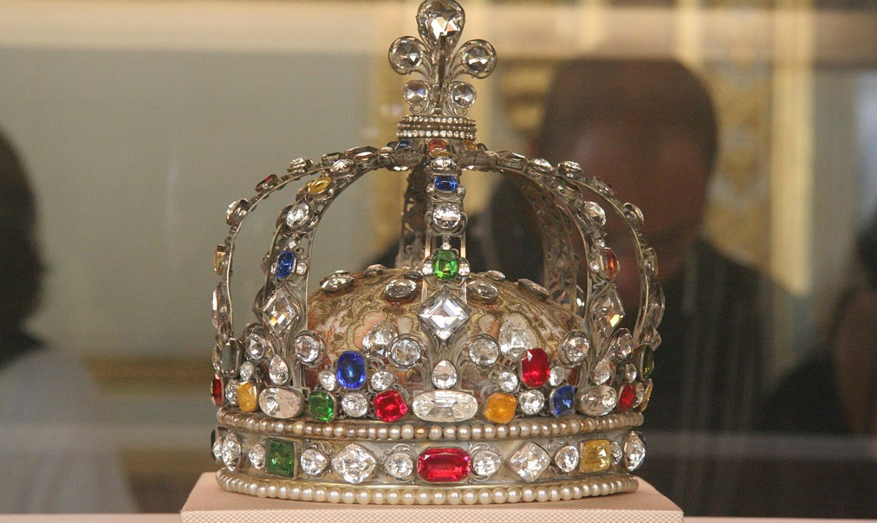
“Crown of king louis” by John Salatas is licensed under CC BY 2.0

Slide 6
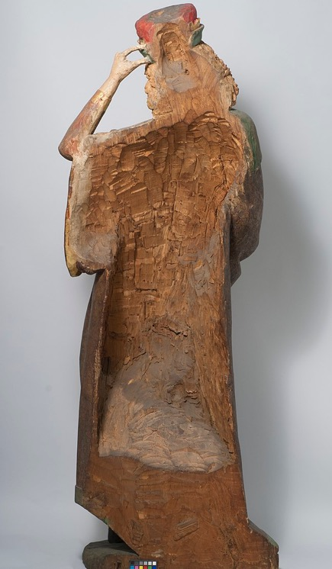

“Balthasar” by Pharos is licensed under CC BY 2.0

Slide 7
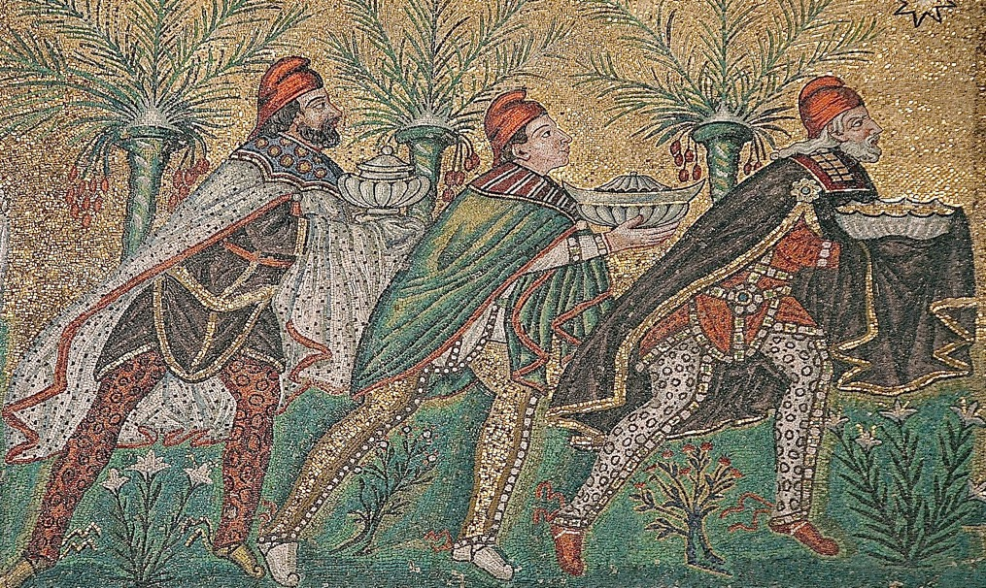
“Magi” by Nina-no is licensed under CC BY 2.0

Slide 8
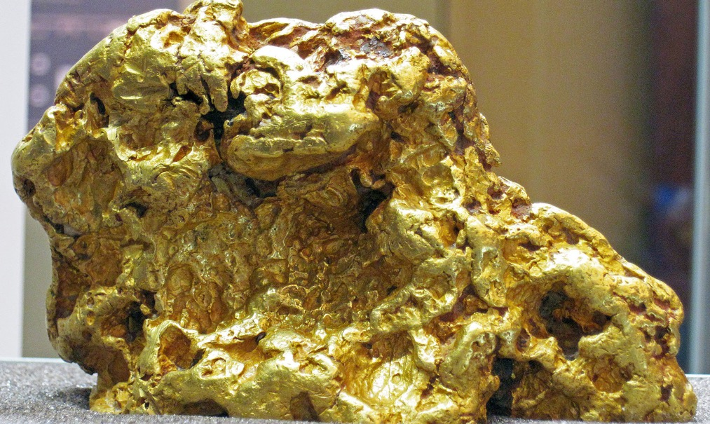
“Gold Nugget” by Jacopo Werther is licensed under CC BY 2.0

Slide 9
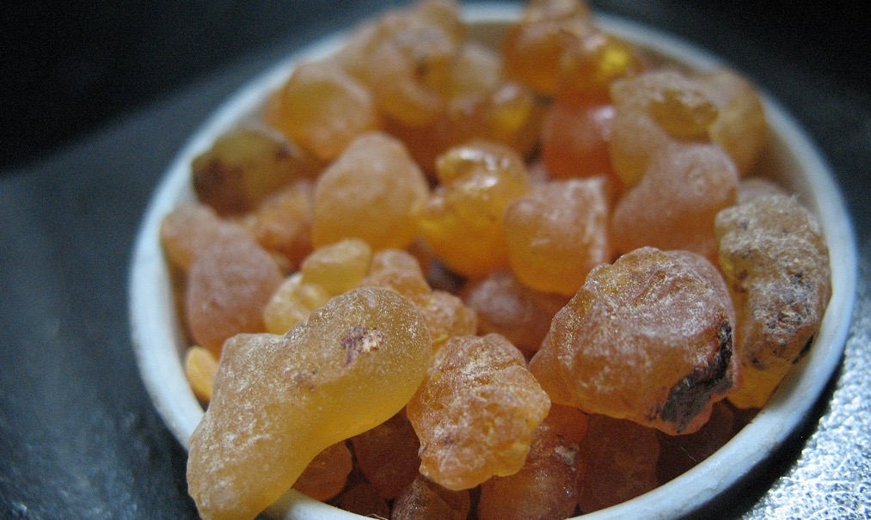
“Frankincense” by Lupus in Saxonia is licensed under CC BY 2.0

Slide 10
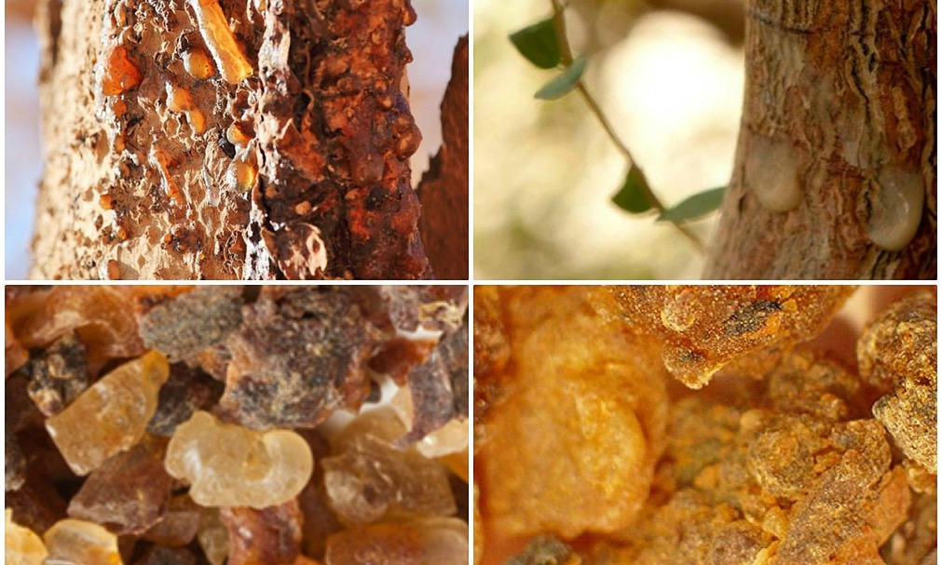
“Myrrh” by CWatchman is licensed under CC BY 2.0

Slide 11
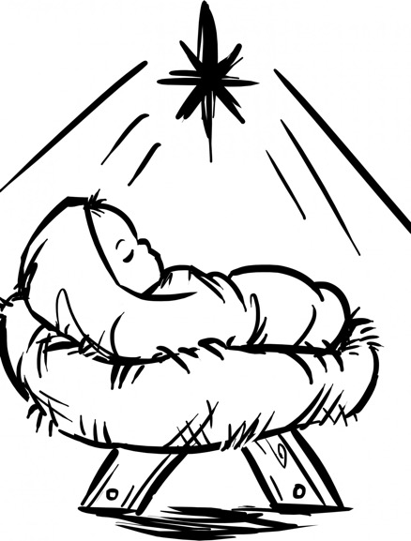
“Baby Jesus” by Colleen O'Dell is licensed under CC BY 2.0

Slide 12

“Old Bethlehem” by Bob Comix is licensed under CC BY 2.0

Slide 13
Slide 1 is stars in the night sky.
Slide 6 is gold.
Slide 2 is camels.
Slide 7 is frankincense.
Slide 3 is a crown.
Slide 8 is myrrh.
Slide 4 is a statue depicting the Wise Man Balthazar.
Slide 9 is baby Jesus in a manger.
Slide 5 is a mosaic of the Three Kings.
Slide 10 is a drawing of Bethlehem as it would have been during Jesus’ time.

