Slide 1
Room on the Broom
How can we use the story to help us to count?

Slide 2
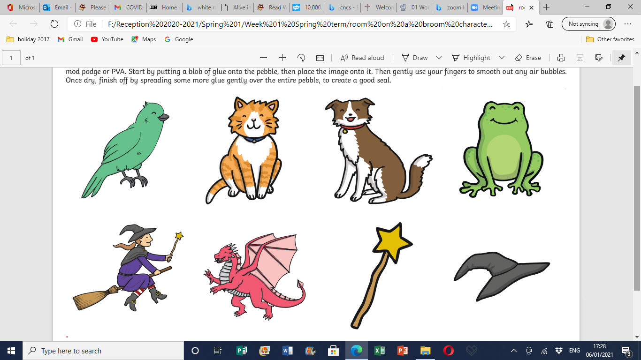
How many are able to fit on the broom?

Slide 3
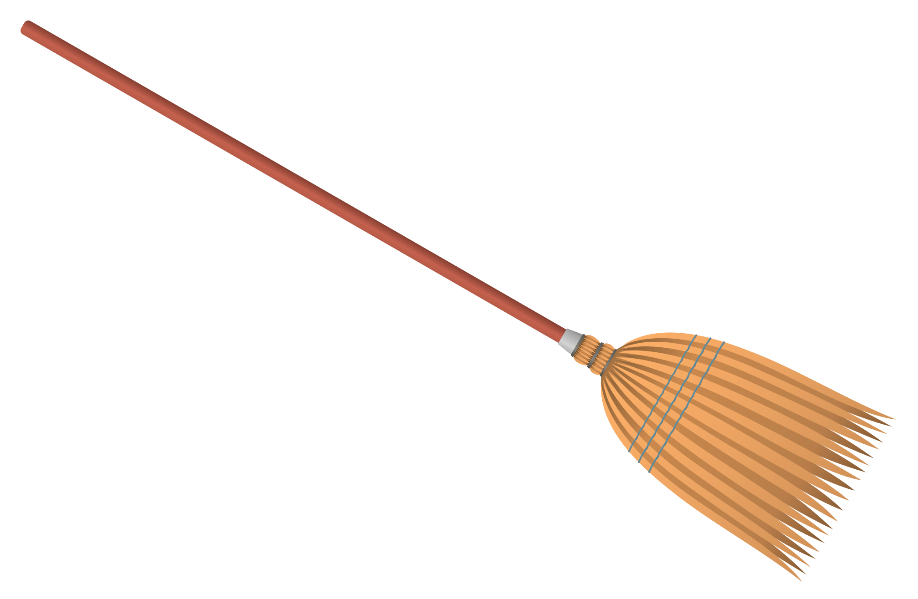
How many fit on the broom?

Slide 4
How many fit on the broom?
2
4
5
1
3

Slide 5
How many fit on the broom?
2
4
5
1
3

Slide 6
How many fit on the broom?
2
4
5
1
3

Slide 7
How many fit on the broom?
2
4
5
1
3

Slide 8
How many fit on the broom?
2
4
5
1
3

Slide 9
How many fit on the broom?
2
4
5
1
3

Slide 10
How many fit on the broom?
5 = 0 + 5
2
4
5
1
3

Slide 11
How many fit on the broom?
5 = 1 + 4
2
4
5
1
3

Slide 12
How many fit on the broom?
5 = 2 + 3
2
4
5
1
3

Slide 13
How many fit on the broom?
5 = 3 + 2
2
4
5
1
3

Slide 14
How many fit on the broom?
5 = 4 + 1
2
4
5
1
3

Slide 15
How many fit on the broom?
5 = 5 + 0
2
4
5
1
3

Slide 16
Your Challenge…
Can you create your own Room on the Broom?
You could draw the characters.
You could make puppets.
You could build them from Lego / Duplo
Can you create your own number sentences – numbers up to 5. adding and taking away your characters on your broom. (Use a real broom if you can!)

