Slide 1
How to cope with the feeling of disappointment…
What can you do?

Slide 2
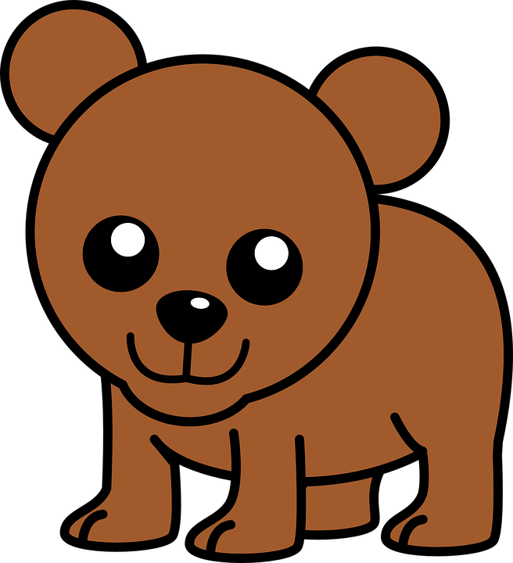
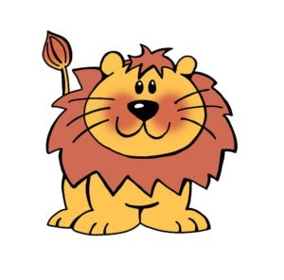
Coping with disappointment
Lion and Bear are very good friends. They need some help to make themselves feel OK. Things keep happening to them that they did not know were going to happen.
What has happened to us that we were not expecting to happen?
There are many things every day that we are disappointed by.

Slide 3
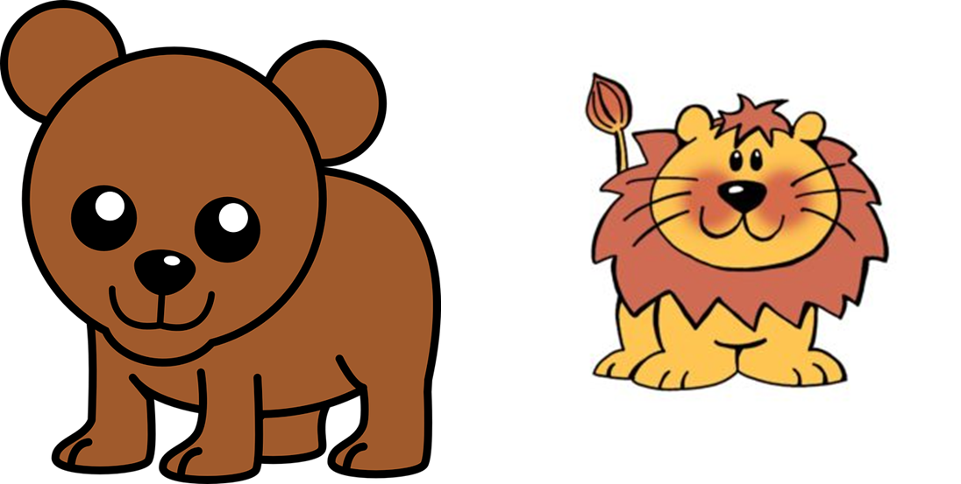
Here is the situation Lion and Bear found themselves in…
Lion and Bear are so excited to see the sun out – they manage to persuade Mummy Bear to get the paddling pool out. The pool is ready the inflatables are blown up and they are ready to go!

Slide 4



All of a sudden, the sky goes dark, and the rain starts to fall.
This Photo by Unknown Author is licensed under CC BY-SA
This Photo by Unknown Author is licensed under CC BY-NC

Slide 5
What might Bear and Lion be saying?
What might Bear and Lion be saying to themselves in their head? ‘I am fed up. I wanted to go in the paddling pool, now I can’t.’
What could they say?
How could they turn it into a happy thought instead?

Slide 6
Turning sad to happy
We need to try and turn the thoughts in our head to happy thoughts.
Can we think about all of the things that may make them happy?

Slide 7
Your challenge…
Can you make 2 puppets
or
One puppet with a double face – sad on one side and happy on the other.

Slide 8


