Slide 1
Disclaimer/s
We hope you find the information on our website and resources useful.
Animations
This resource has been designed with animations to make it as fun and engaging as possible. To view the content in the correct formatting, please view the PowerPoint in ‘slide show mode’. This takes you from desktop to presentation mode. If you view the slides out of ‘slide show mode’, you may find that some of the text and images overlap each other and/or are difficult to read.
To enter slide show mode, go to the slide show menu tab and select either from beginning or from current slide.
You may wish to delete this slide before beginning the presentation.

Slide 3
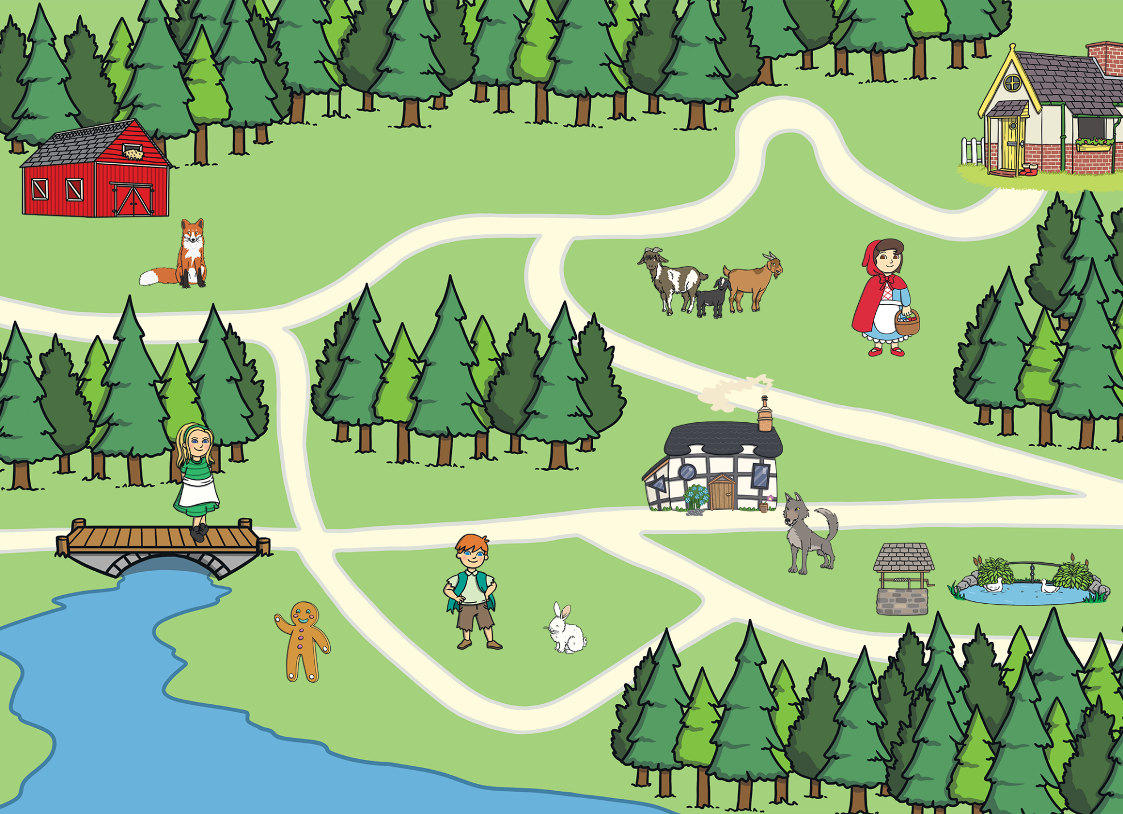
Oh no! Some of the characters from our favourite fairy tales need some help to find their way. Can you use the map on each slide to help them?
Remember, there may be more than one way to solve the problem and answer the question.

Slide 4
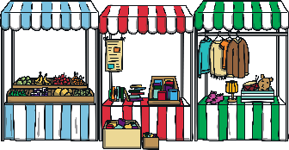
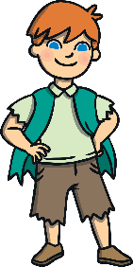
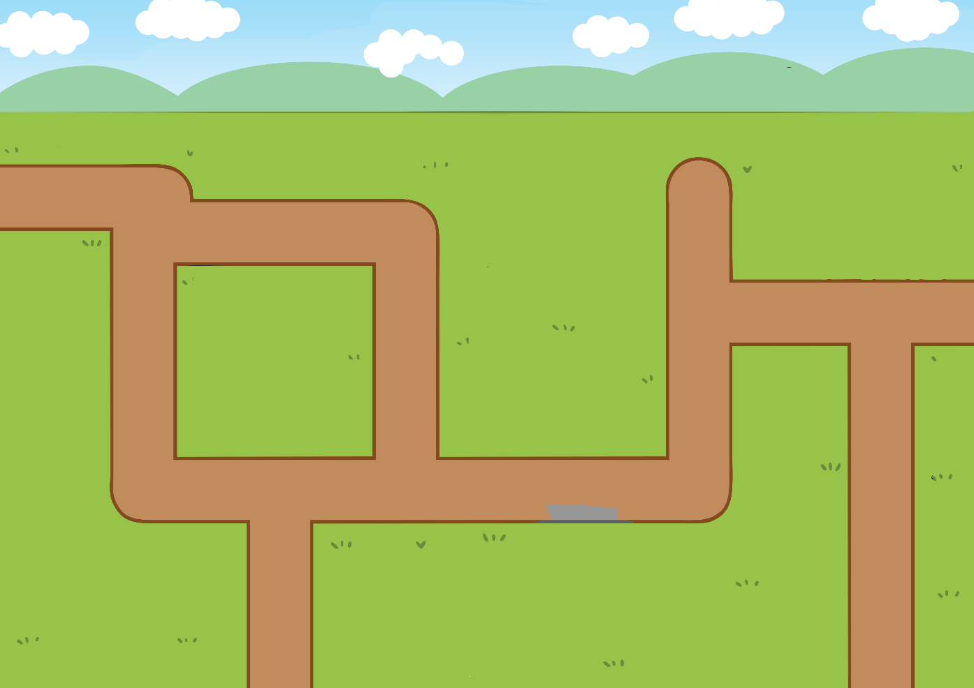
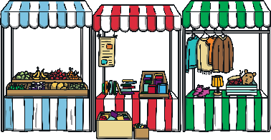
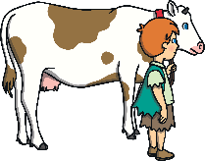
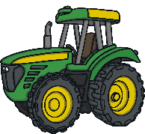
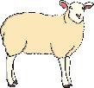
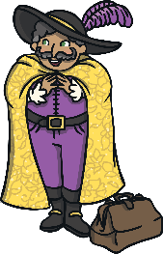
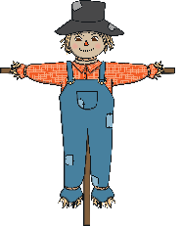
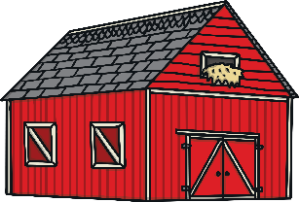

Jack and the Beanstalk
How will Jack get to the market to sell his cow? Describe a route that he could take.
This is the market.
This is Jack.
Do you think he will get all the way to the market without stopping to talk to the mysterious man with a bag of seeds?

Slide 5
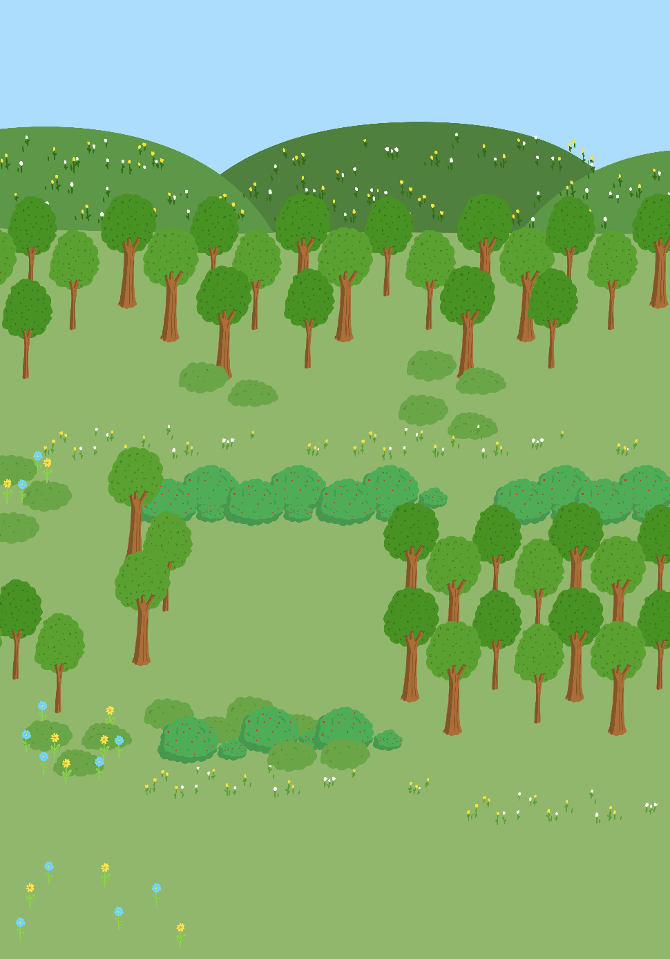

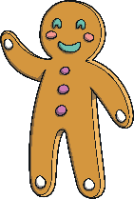
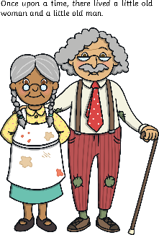

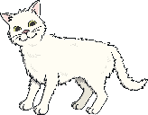
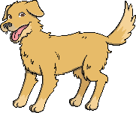
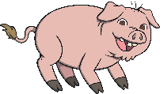
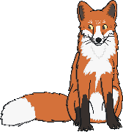
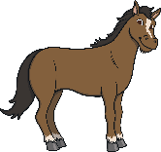

The Gingerbread
Man
This is The Gingerbread Man.
This is the river.
Which way do you think The Gingerbread Man will run to get to the river? Will he meet the characters in the same order as the story or a different order?

Slide 6
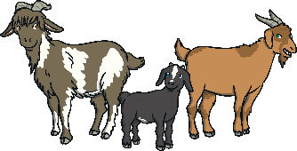
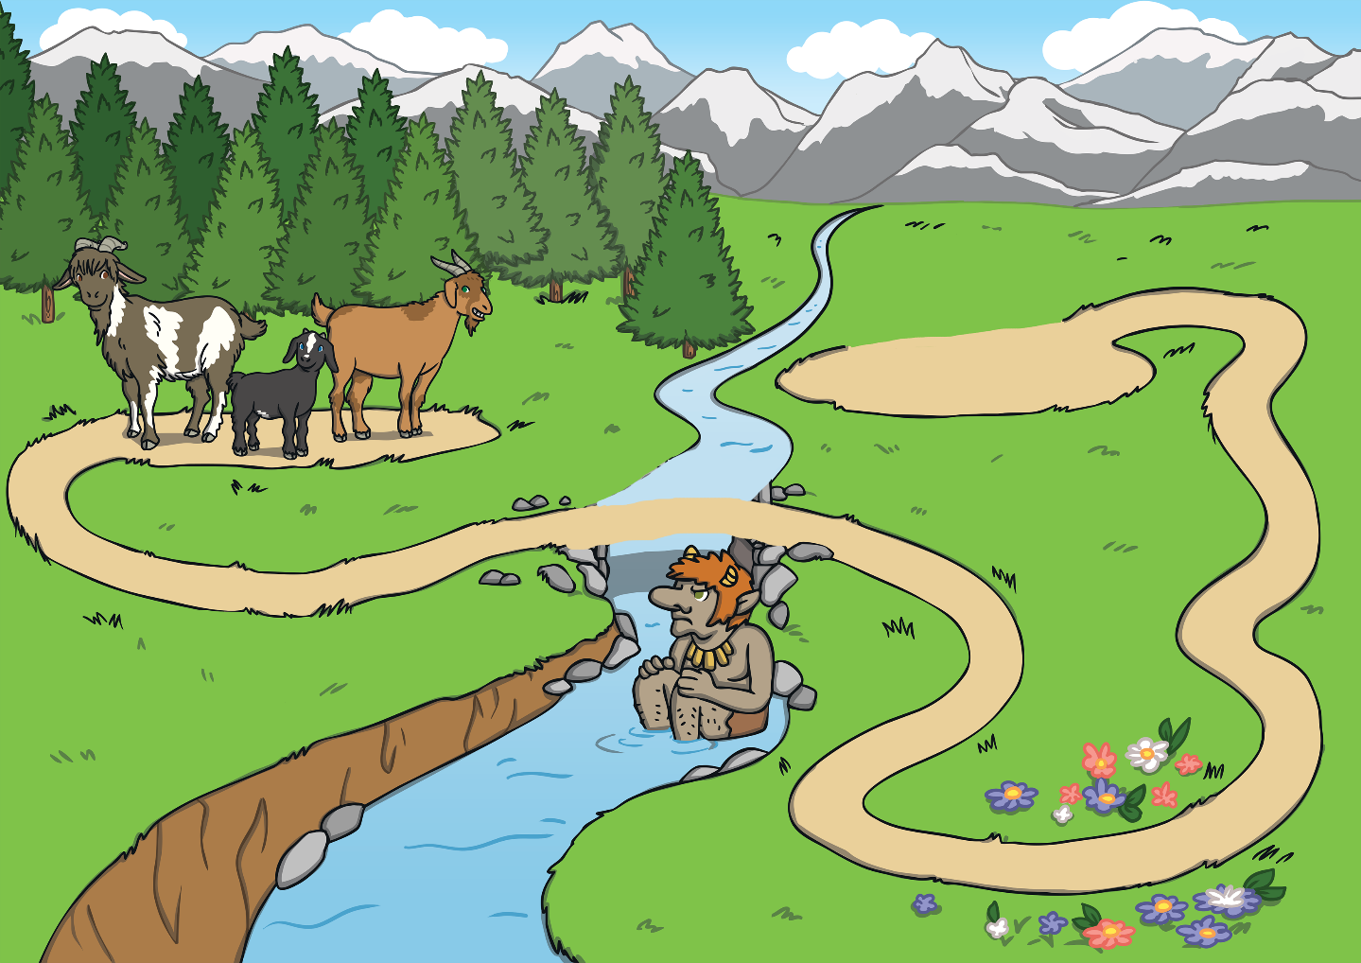


Three Billy Goats Gruff
These are the three Billy Goats Gruff.
This is the bridge.
Can you help the three Billy Goats Gruff find their way to the bridge? What will they pass on the way?

Slide 7
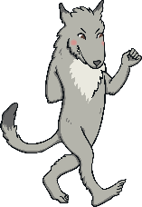
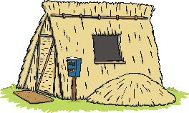
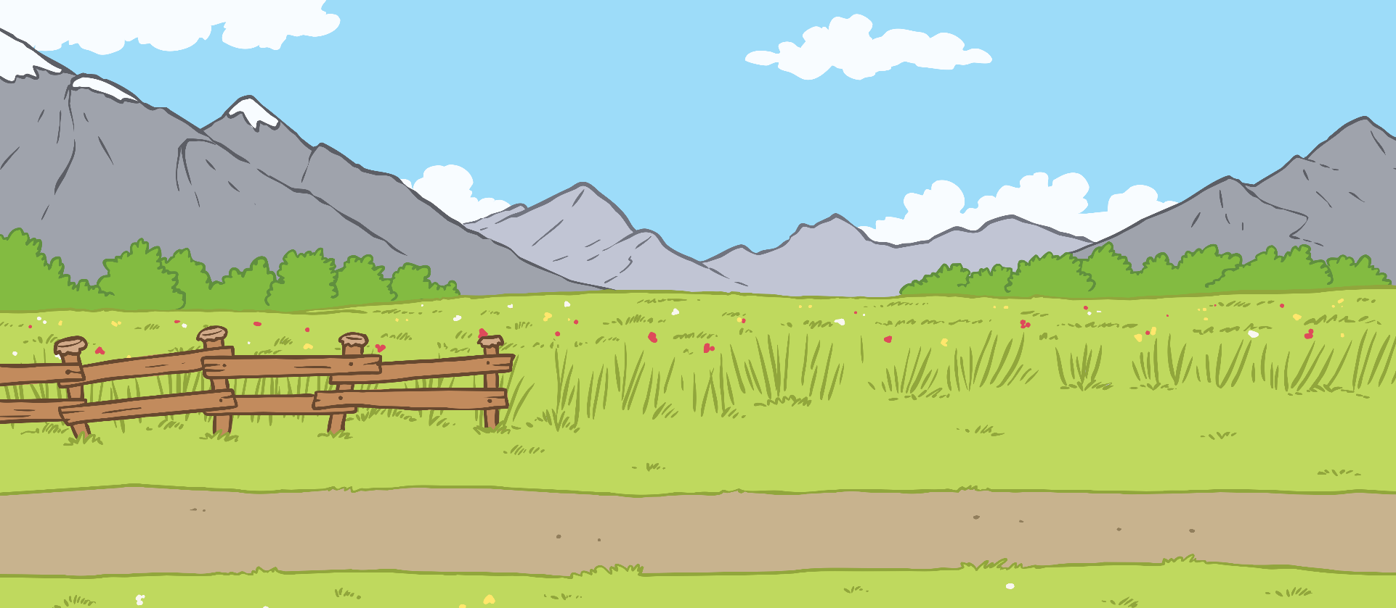
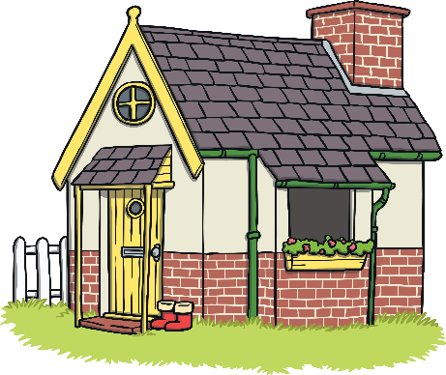
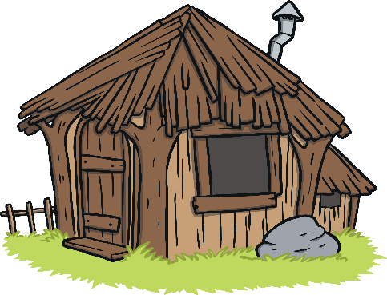
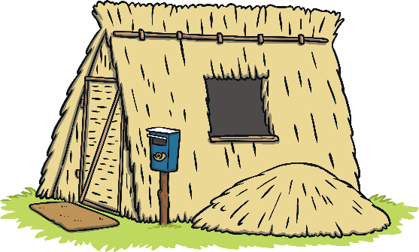
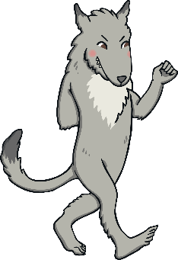

Three Little Pigs
This is the Big Bad Wolf.
Can you describe the straw house to the wolf? You might want to think about what the straw house is next to or in-between. Alternatively, you might count how many other houses he will pass before he reaches the straw house.
This is the straw house.

Slide 8
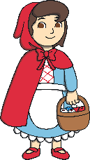
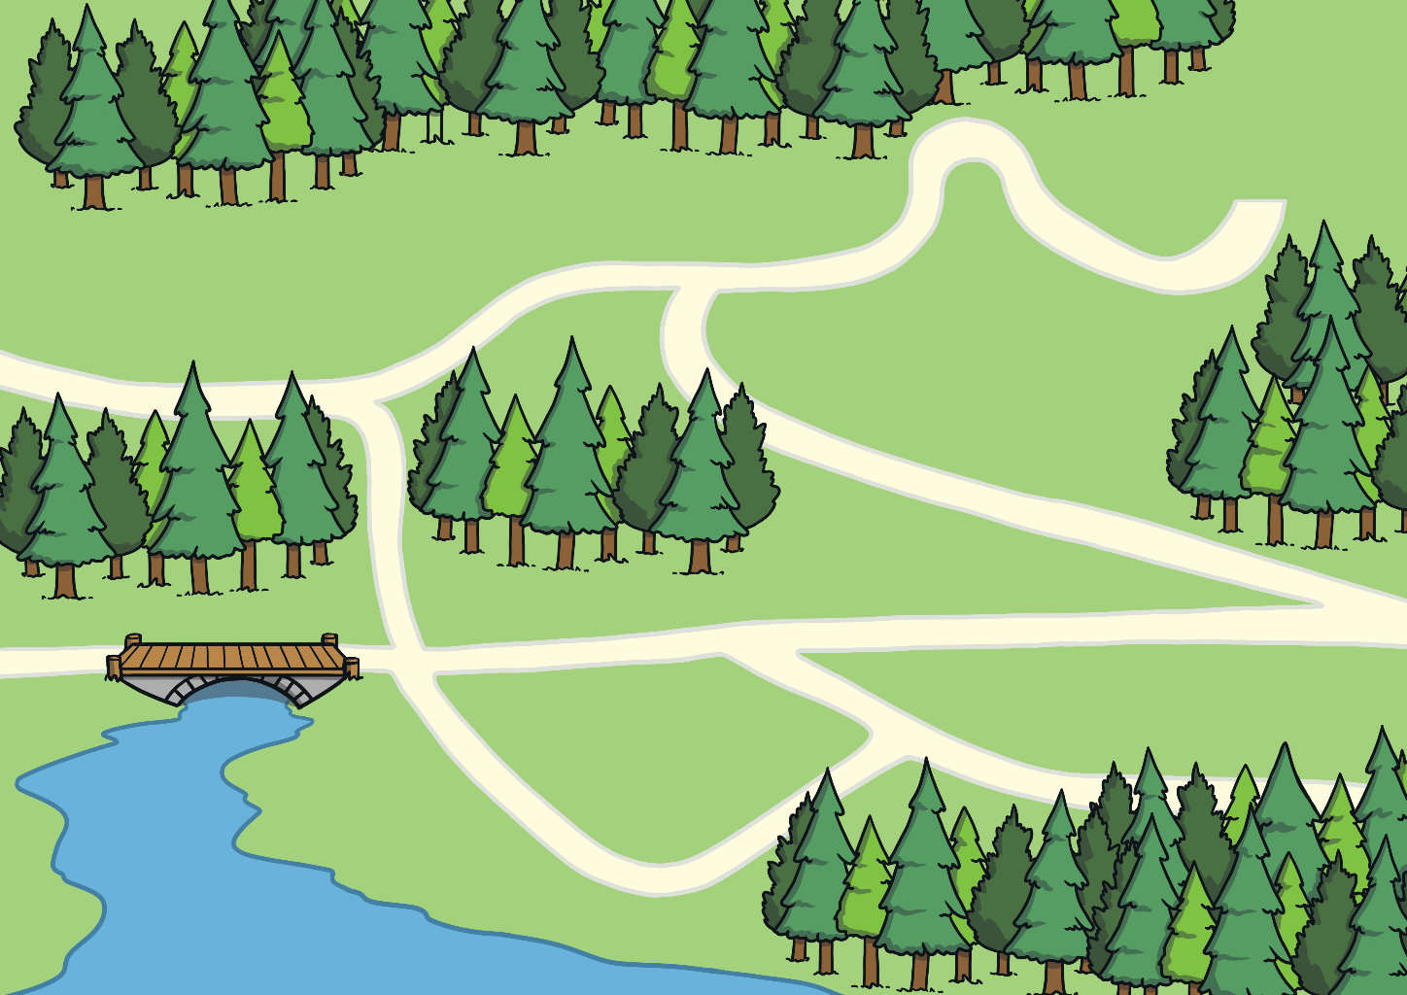






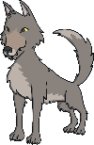


Little Red Riding Hood
Can you help Little Red Riding Hood find her way to Grandma’s cottage without going past the wolf?
This is Little Red Riding Hood.
This is Grandma’s Cottage.

Slide 9

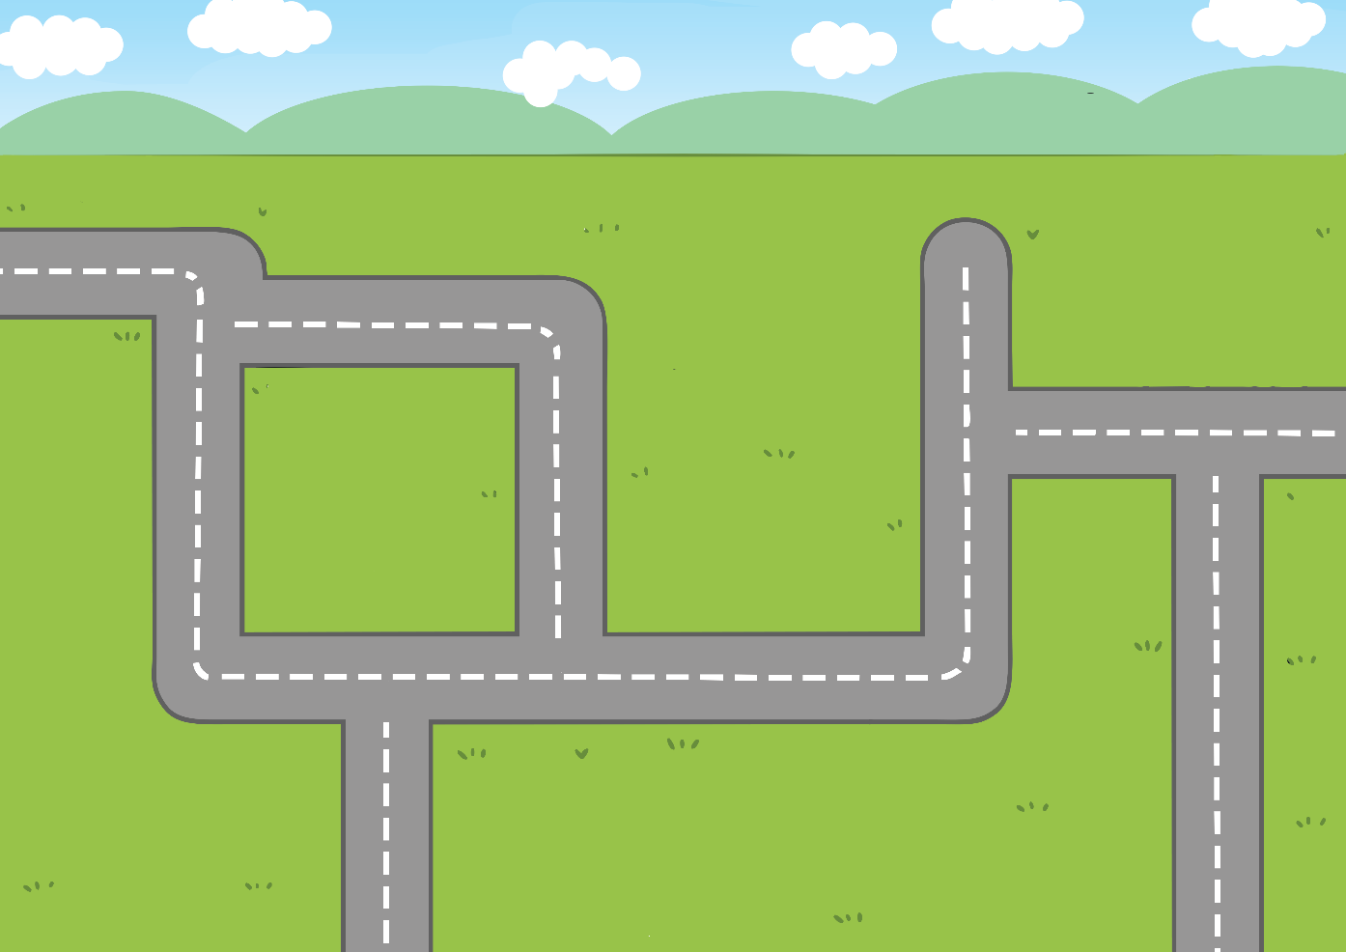


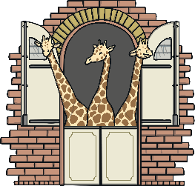

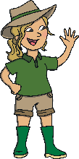

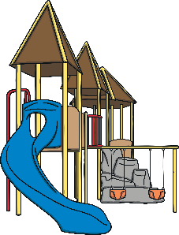
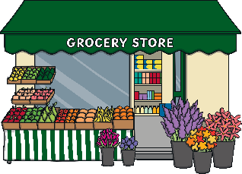

Goldilocks and the Three Bears
Goldilocks decided she didn’t want to go the cottage. Can you use the map to tell her where she could visit instead?
This is Goldilocks.
This is the three bear’s cottage.

Slide 10




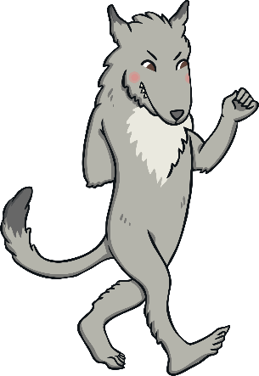

Well done! You have helped all of the characters from the fairy tales to find their way. Now, use the map on the next slide to think about some places you might like to visit.
Thank you!
Thank you!
Thank you!
Thank you!
Thank you!
Thank you!

Slide 11
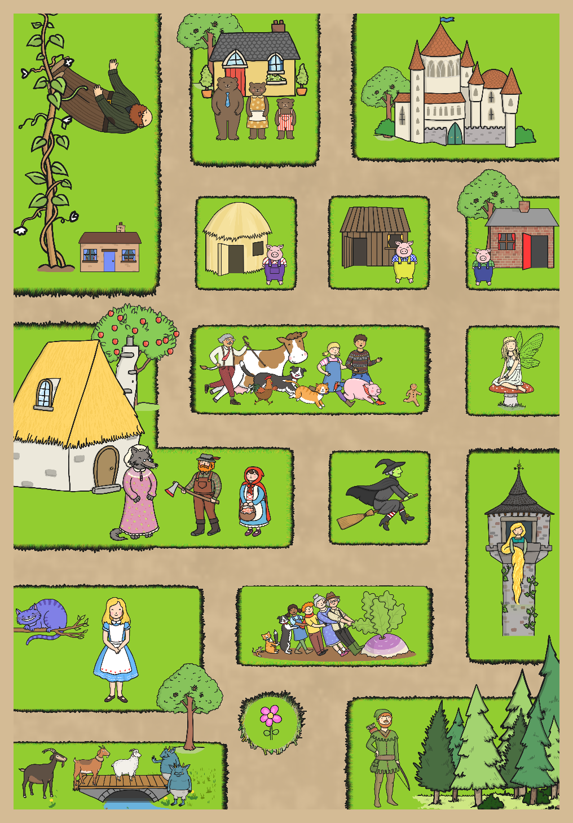
Fairy Tale Map
Look at this map of Fairy Tale Land.
Which place would you most like to visit? What might you pass on the way? Who will you find nearby? Is there anywhere you wouldn’t like to visit?
Then, in talk partners, describe a route to a place on the map for your partner to guess. Can they work out where they will end up? Swap over roles – listen to your partners description and guess where they would like to visit.

