Slide 1

Nursery and Reception Our World

Slide 2

Photo Album
by auser

Slide 3
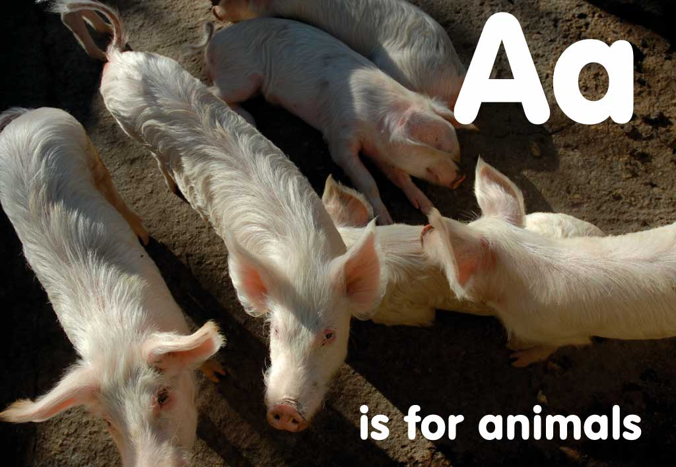




Slide 4



Slide 5
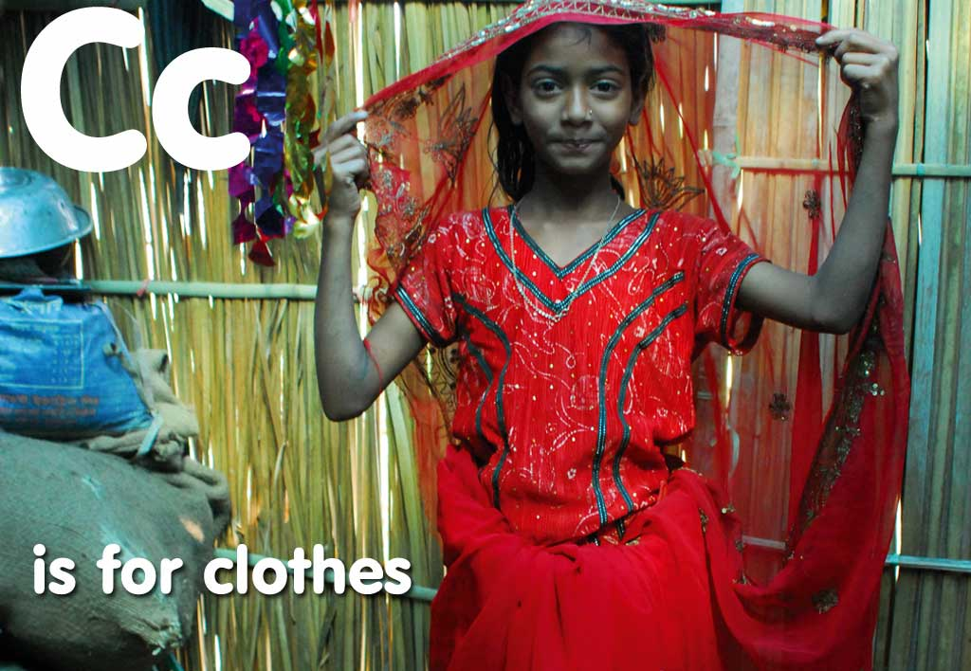


Slide 6



Slide 7
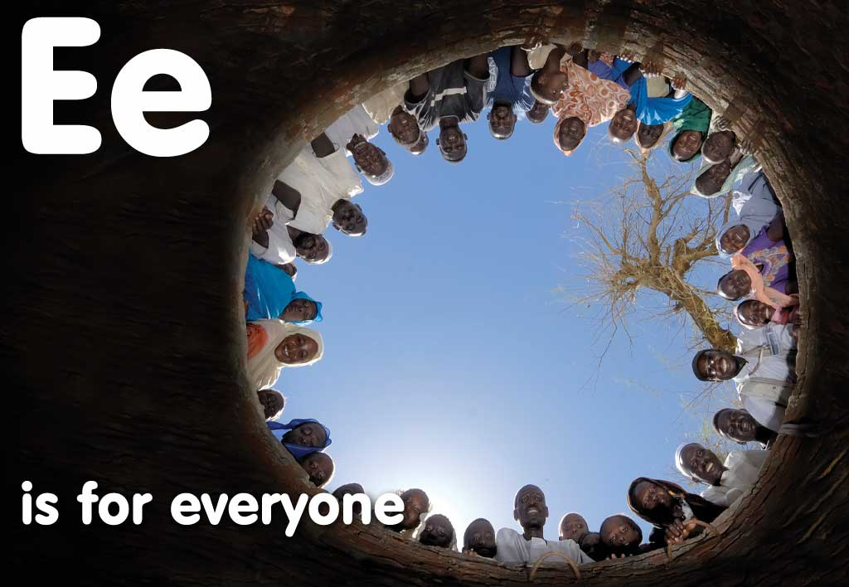


Slide 8
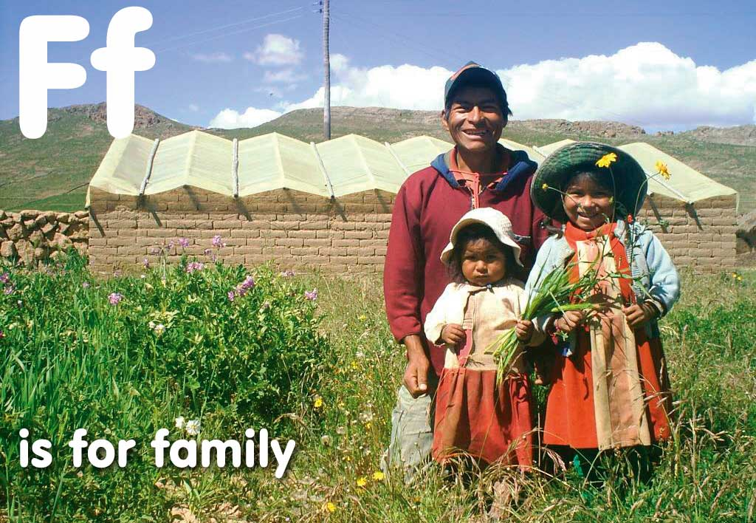


Slide 9
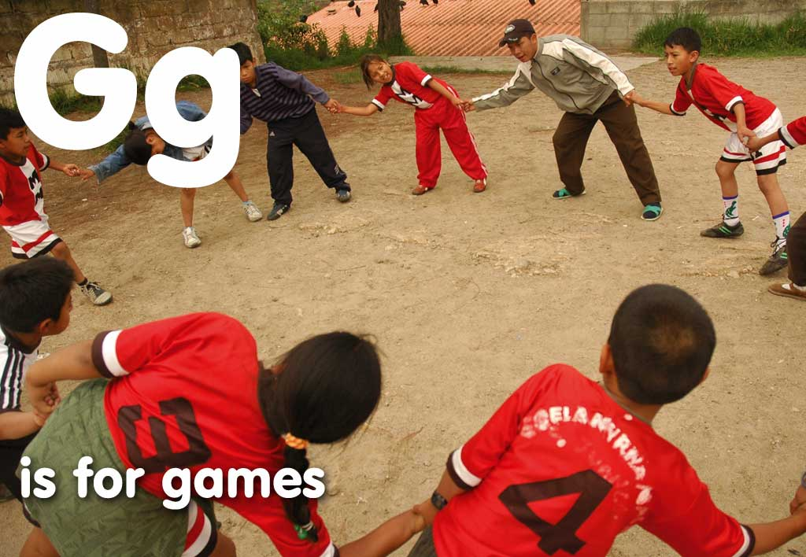


Slide 10



Slide 11



Slide 12



Slide 13



Slide 14



Slide 15



Slide 16



Slide 17



Slide 18
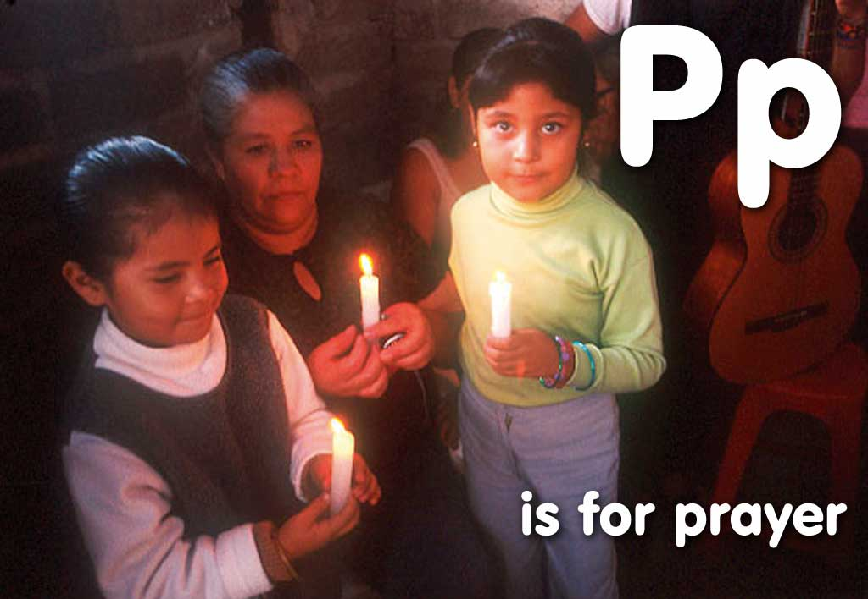


Slide 19



Slide 20



Slide 21



Slide 22
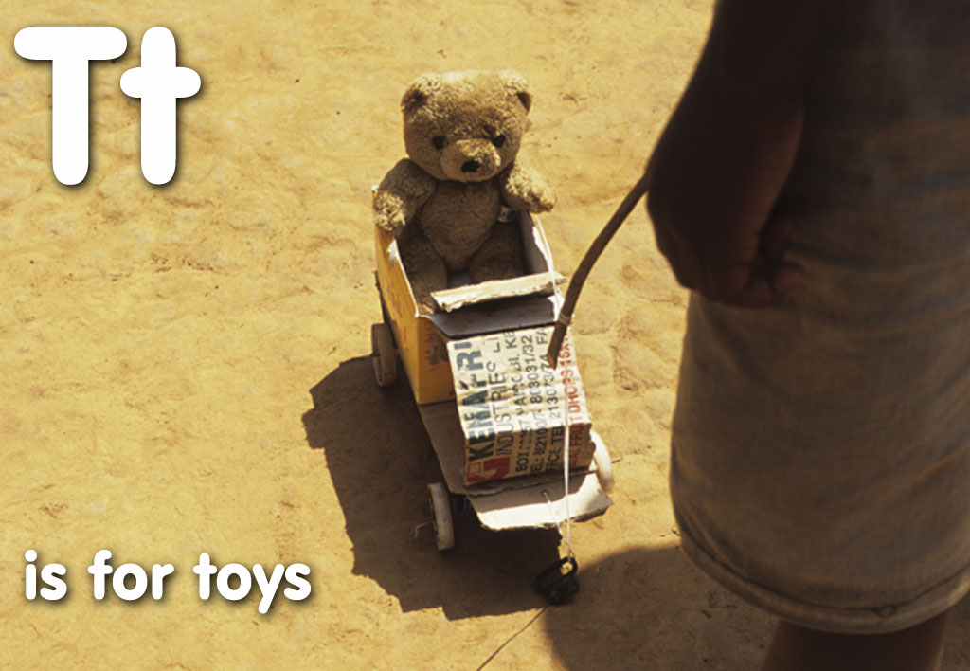


Slide 23
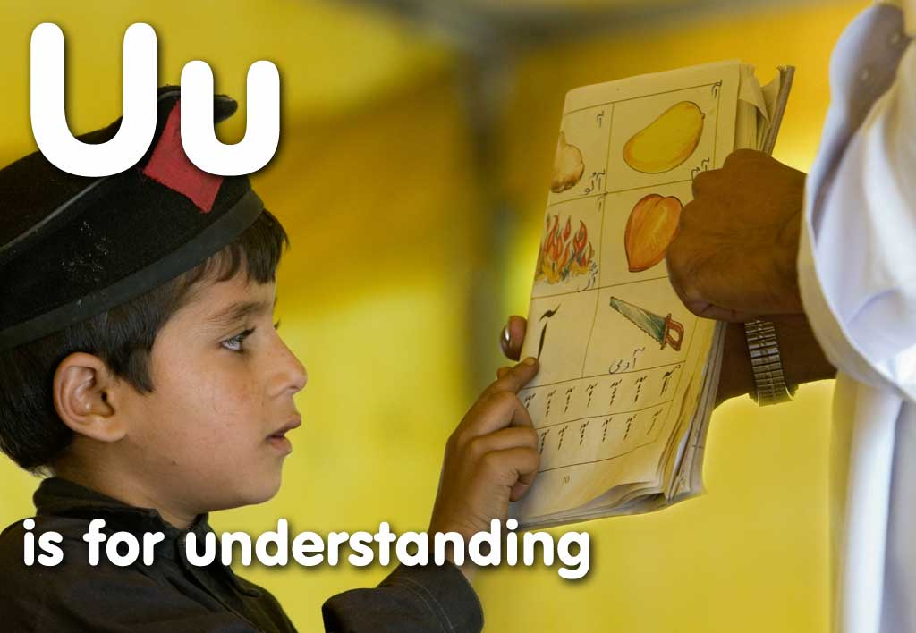


Slide 24



Slide 25



Slide 26



Slide 27



Slide 28



Slide 29
Photo Credits: CAFOD, Annie Bungeroth, Caroline Irby, Paul Jeffrey, Claire Goudsmit, Richard Wainwright, Bridget Naylor, Jon Spaull, Marcella Haddad, Amelia Bookstein, Danielle Pellegrini/ Science Photo Library, Jim Stipe, Simon Rawles, Julius Mwelu, Jim Holmes, Alem Assefa, Yenenesh Abraham.
Illustrator: Ryoko Tamura

