Slide 2
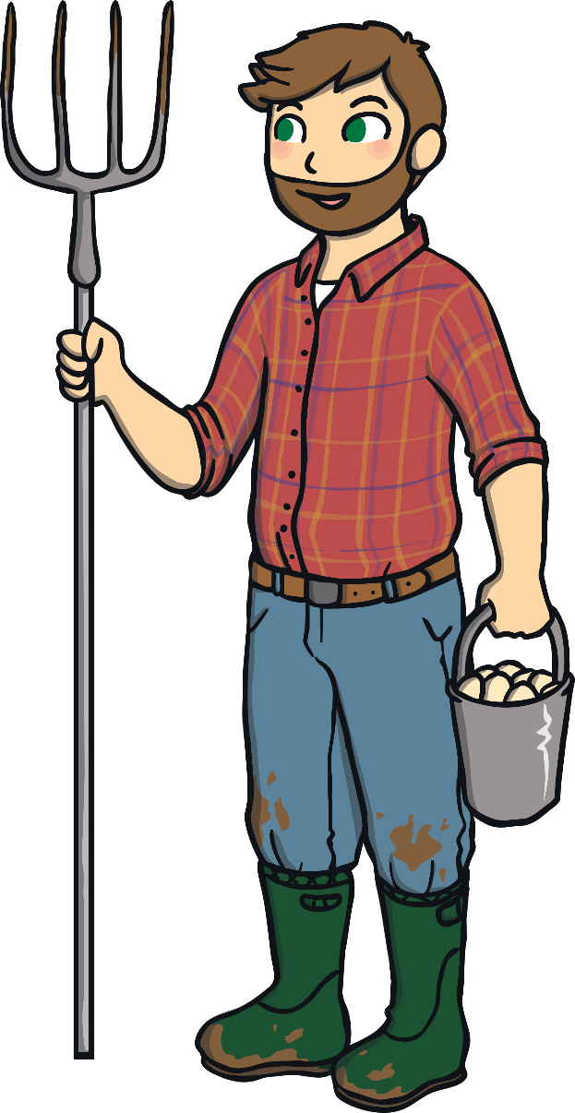
Instructions
There is a hungry rabbit on the farm who keeps digging up all of my number carrots!
Can you help me work out which carrots the rabbit takes?

Slide 3

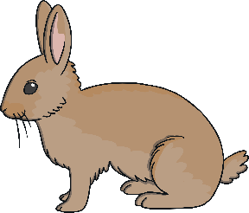

The rabbit took a carrot! What number carrot did the rabbit take? Click the rabbit to take the carrot.
1
2
4
3
6
7
Click on the number the hungry rabbit took.

Slide 4
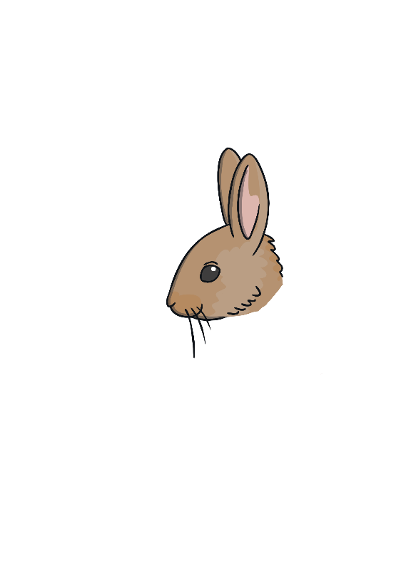
I took the number 3 carrot.
Now I’m going to look for some more number carrots!
1
2
3
4
Next

Slide 5
How can we work out which carrot the hungry rabbit took? Click the rabbit to take the carrot.
5
7
8
3
11
6
Click on the number the hungry rabbit took.

Slide 6
I took the number 6 carrot.
Now I’m going to look for some more number carrots!
5
6
7
8
Next

Slide 7
I think the hungry rabbit took number carrot 8. Am I correct? Why? Why not? Click the rabbit to take the carrot.
9
11
12
16
10
4
Click on the number the hungry rabbit took.

Slide 8
I took the number 10 carrot.
Now I’m going to look for some more number carrots!
9
10
11
12
Next

Slide 9
Can you count up from 13 to find the number carrot the rabbit took? Click the rabbit to take the carrot.
13
14
16
5
11
15
Click on the number the hungry rabbit took.

Slide 10
I took the number 15 carrot.
Now I’m going to look for some more number carrots!
13
14
15
16
Next

Slide 11
What number carrot is at the end of the row? Click the rabbit to check.
17
18
19
12
20
13
Click on the number the hungry rabbit took.

Slide 12
I took the number 20 carrot.
Uh oh, here comes the farmer!
17
18
19
20
I took the number 20 carrot.
Uh oh, here comes the farmer!
Next

Slide 13

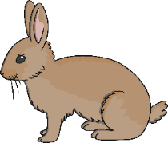
Thank you for helping me work out which number carrots the rabbit took.
I will harvest these carrots and share them with the hungry rabbit!
Can you say the numbers below to check we have all of the number carrots?
2
12
13
14
16
18
20
1
3
4
5
6
7
8
9
10
11
15
17
19

