Slide 1
Reading with your child at home
A guide for families and parents

Slide 2


Slide 3
Why read?
Build pictures in your mind from the words on the page
Learn new vocabulary and phrases: for speaking and writing
Think about the feelings of others
Understand suspense and make predictions
Appreciate rhythm and rhyme
Understand humour and irony
Learn new knowledge of the world
Follow a plot with twists and turns
Link sentences and ideas together
Reading opens up new words, worlds and is linked to happiness

Slide 4










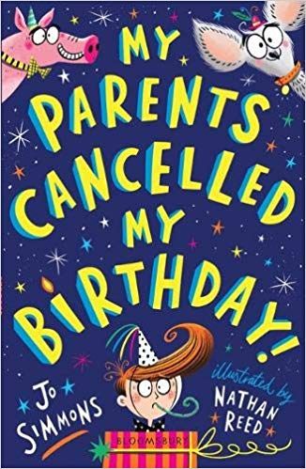


At school
Children have daily reading sessions.
Children in Reception and Year One follow the Read Write Inc scheme.

Slide 5

At home
Children should bring home reading books in their book bags.
Reception and Year One:
Read Write Inc Book – related to words and sounds studied in groups.
Oxford Reading Tree – book related to reading level
Picture / library book
Year Two and above:
Reading book linked to ZPD reading level

Slide 6

Reception and Year One
The Read Write Inc book bag book closely links to the sounds and words used in the group.
It goes home Monday.
Please return it on Friday.

Slide 7

Top Ten Tips for reading at home
1. Make it feel special
2. Set aside a quiet time of day away from others.

Slide 8

Top Ten Tips for reading at home
3. Show curiosity and interest in what you are going to read.

Slide 9

Top Ten Tips for reading at home
4. Read the story through the first time without stopping too much.
5. Chat about the story (avoid asking too many questions though)

Slide 10

Top Ten Tips for reading at home
6. Link stories to your own and your child’s experiences.

Slide 11

Top Ten Tips for reading at home
7. Read favourite stories over and over again.
8. Read with enthusiasm and expression.

Slide 12

Top Ten Tips for reading at home
9. Do not stop reading to your child when they can read for themselves.

Slide 13

Top Ten Tips for reading at home
10. Above all, read with enjoyment.

Slide 14
Apps

