Slide 1
Alien Words
Can you use your sounds to create the Alien Words?

Slide 2
2 letter words
ib

Slide 3
2 letter words
ip

Slide 4
3 letter words
mip

Slide 5
3 letter words
vab

Slide 6
3 letter words
sem

Slide 7
3 letter words
pid

Slide 8
3 letter words
teb

Slide 9
Your challenge…
Have a look at the rest of the Alien Words
Try out the Alien Word challenge
Create your own Alien.
Give your Alien a name. – Use your sounds knowledge to name him.

Slide 10
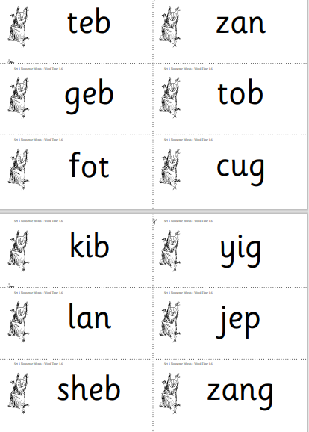

Slide 11
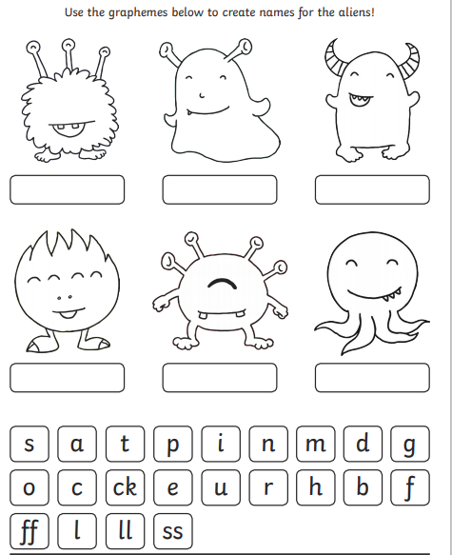

Slide 12
Get Crafty!
I look forward to seeing your Aliens!

