Slide 1
Room on the Broom
How can we use the story to help us to count?

Slide 2
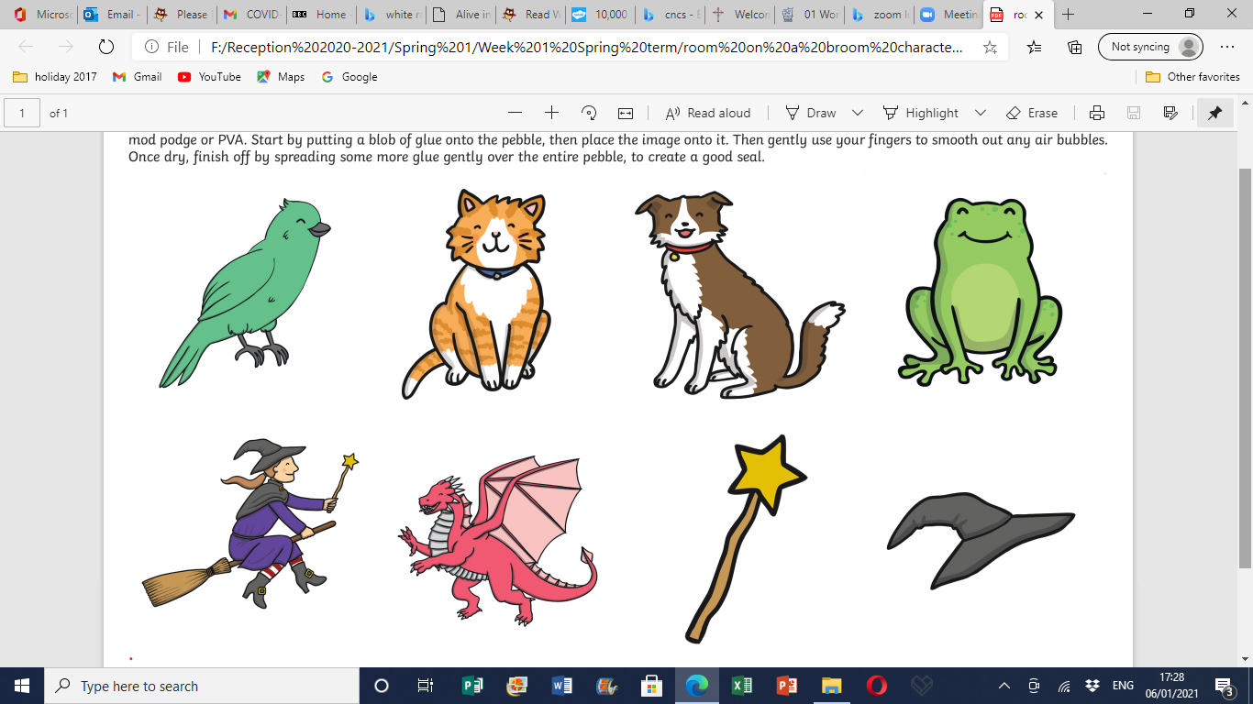
How many are able to fit on the broom?

Slide 3
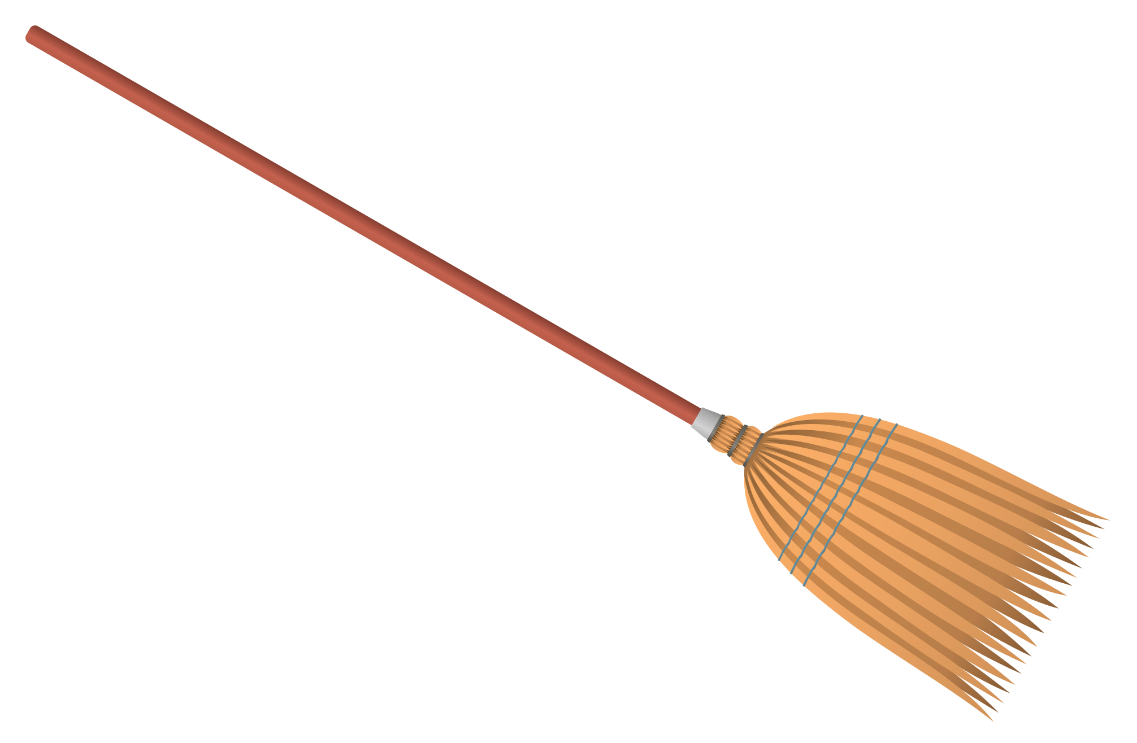
How many fit on the broom?

Slide 4
How many fit on the broom?
2
4
5
1
3

Slide 5
How many fit on the broom?
2
4
5
1
3

Slide 6
How many fit on the broom?
2
4
5
1
3

Slide 7
How many fit on the broom?
2
4
5
1
3

Slide 8
How many fit on the broom?
2
4
5
1
3

Slide 9
How many fit on the broom?
2
4
5
1
3

Slide 10
How many fit on the broom?
5 = 0 + 5
2
4
5
1
3

Slide 11
How many fit on the broom?
5 = 1 + 4
2
4
5
1
3

Slide 12
How many fit on the broom?
5 = 2 + 3
2
4
5
1
3

Slide 13
How many fit on the broom?
5 = 3 + 2
2
4
5
1
3

Slide 14
How many fit on the broom?
5 = 4 + 1
2
4
5
1
3

Slide 15
How many fit on the broom?
5 = 5 + 0
2
4
5
1
3

Slide 16
Your Challenge…
Can you create your own Room on the Broom?
You could draw the characters.
You could use the PDF sheets on the class page for today’s learning.
You could make puppets.
You could build them from Lego / Duplo
You could use your toys.
Can you create your own number sentences – numbers up to 5. adding and taking away your characters on your broom. (Use a real broom if you can!)

