Slide 1
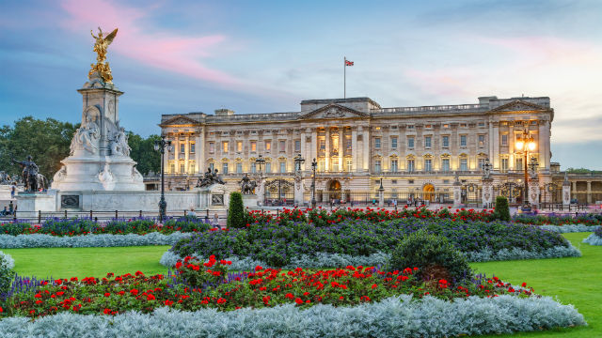
Buckingham Palace

Slide 2
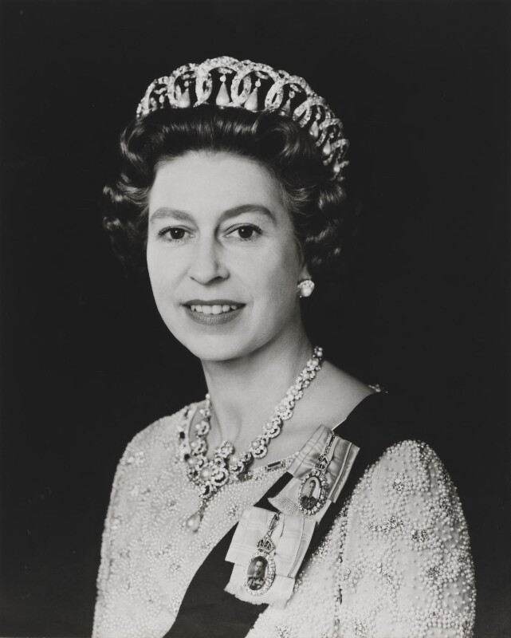
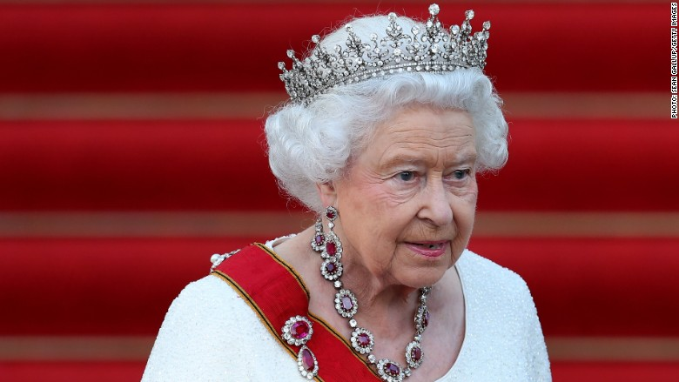
Queen Victoria was the first monarch to rule from
Buckingham Palace in 1837. King Edward VII (7th) used it
during his rule from 1901 – 1910. King George V (5th) and
King George the VII (6th) also used it. Queen Elizabeth II
now lives there.

Slide 3
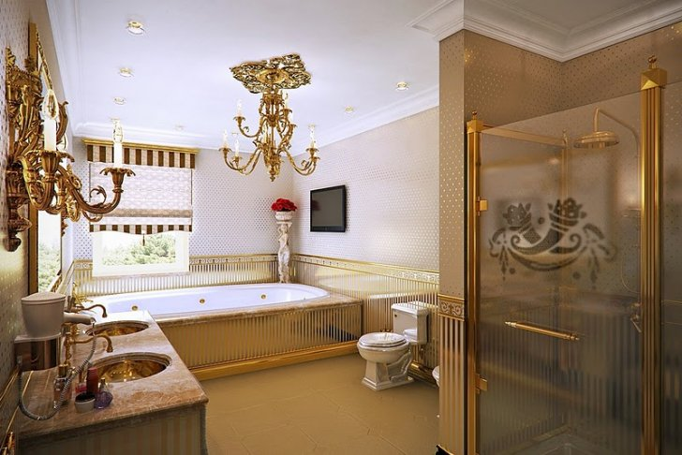
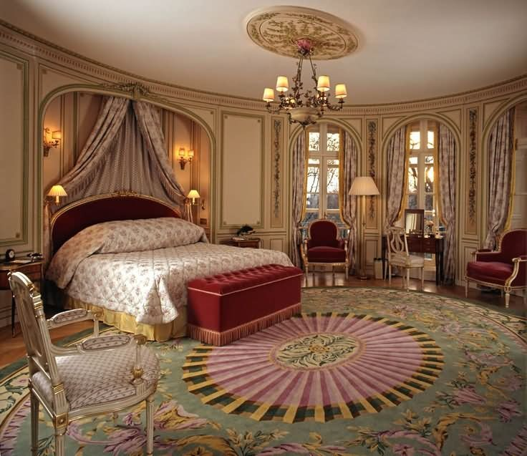
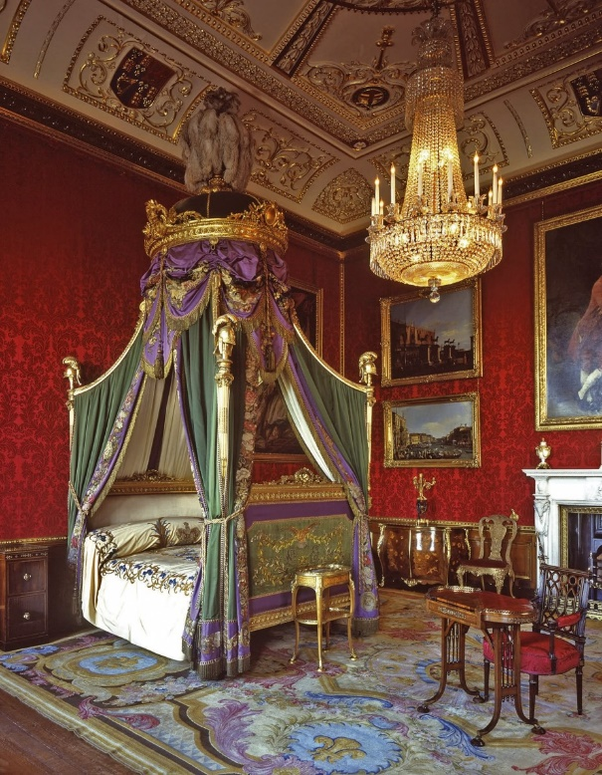
There are 775 rooms and 78 bathrooms in Buckingham Palace!

Slide 4
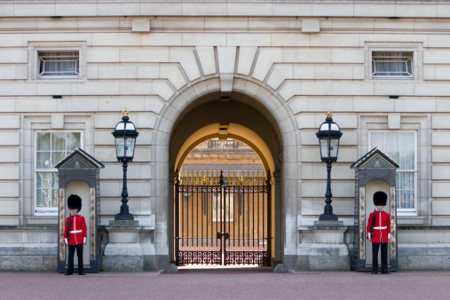
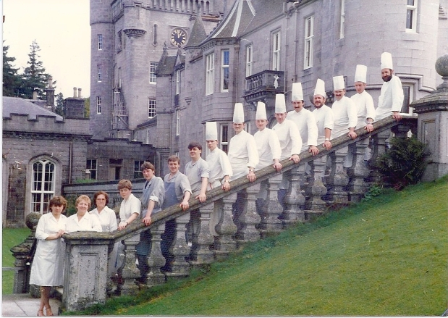
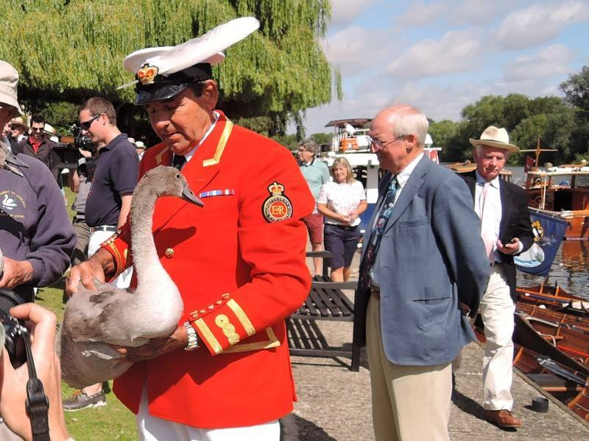
Over 800 people work at Buckingham Palace! They include cooks, maids, musicians, astronomers, medical staff, military people, secretarial staff and even a “Warden of the Swans” and a “Gentleman of the Horse.”

Slide 5
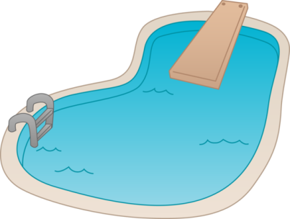
Buckingham Palace has it’s own pool, cinema, tennis court, cafeteria and chapel.

Slide 6
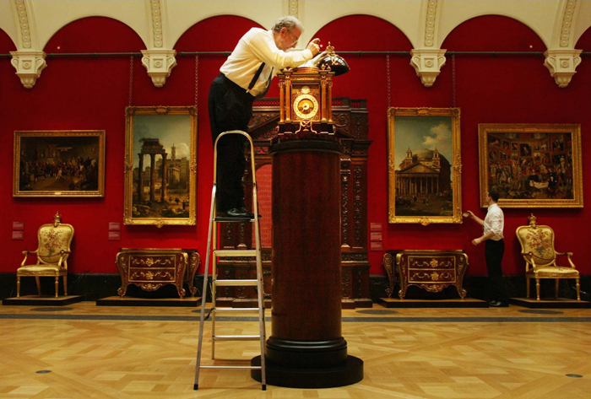
There are 350 mechanical clocks which a team of horologists (clock experts) wind up and care for.

Slide 7
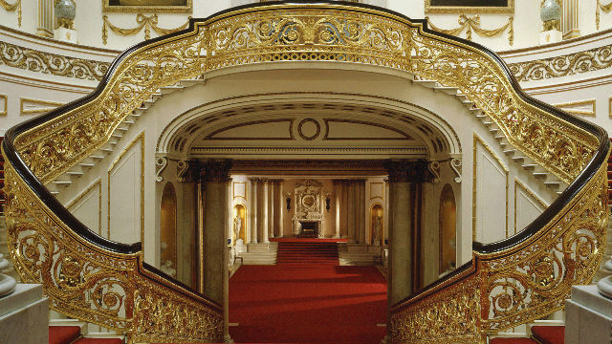
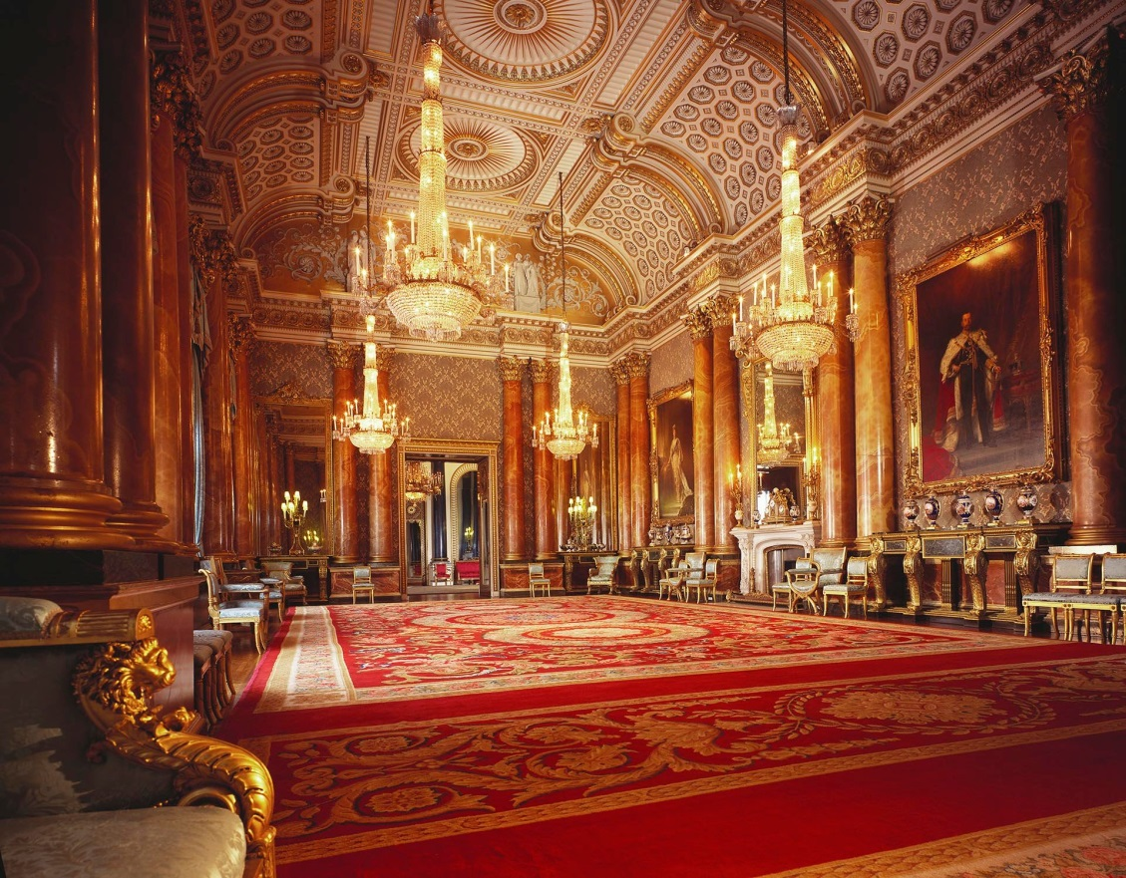
You can go inside some of the rooms at Buckingham Palace but only in the summer months.

Slide 8
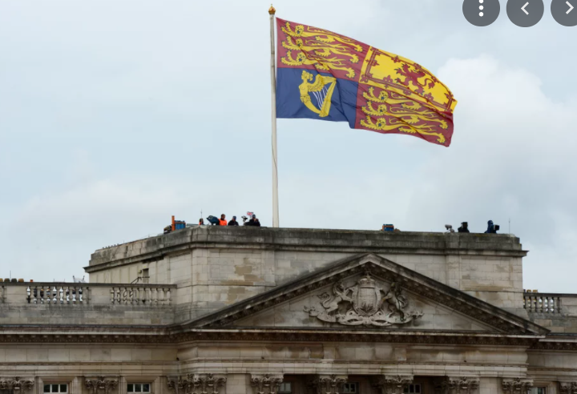
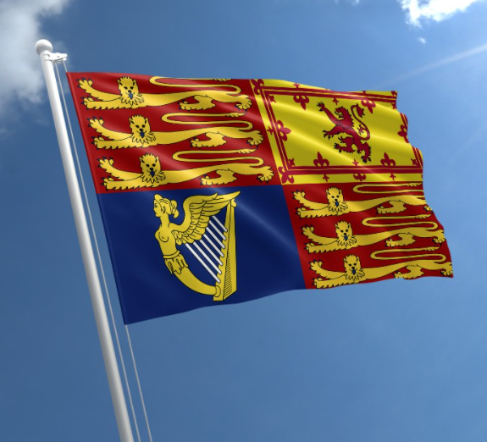
When is the Queen home?
When the Queen is home, the Royal Standard flag is flying above the palace. Otherwise, it is the Union Jack.

Slide 9
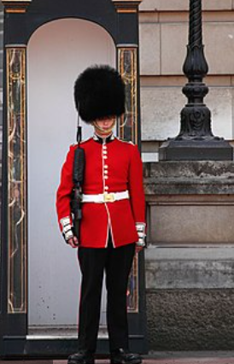
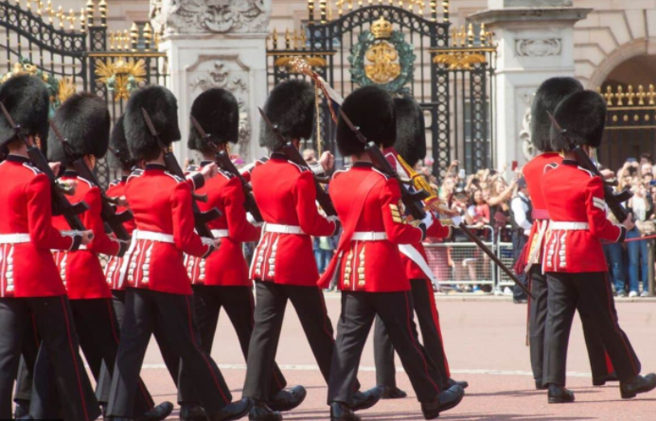
Who protects the Queen?
The Queen’s guards are responsible for guarding the Queen’s homes. Changing of the guards, happens every other day.

